Slide 1
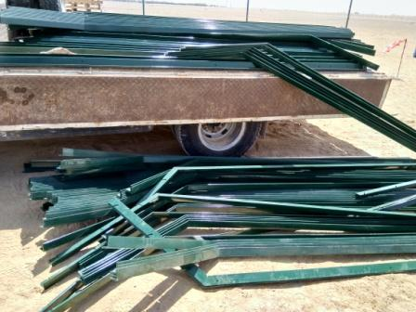
SAFETY MOMENT

Slide 2
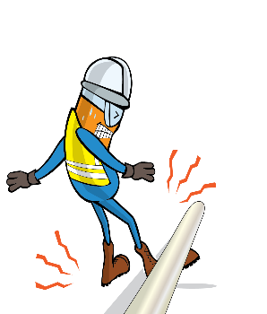


PDO Incident First Alert - Galfar Engineering
Incident type | LTI (#15)
Date/ time | 10.10.2019 at 10:58 hrs. | Directorate | Project Delivery
Location | Saih Rawl | Dept | PDC
What happened
While the technician was opening the side panel of a canter to start the offloading activity, the load suddenly dropped on the technician, fracturing his left leg.
Mr. Musleh asks the questions of can it happen to you?
Do you ensure that loads are correctly secured before beginning unloading?
Do you ensure that you are stood in a safe place?
Can this be done with mechanical aids?
Do you assess the weight of an object before manual handling?
Do you ensure you are out of the “Line of fire”?
CAN THIS HAPPEN TO YOU ?!!
Please disseminate this LTI notification to your teams and use it in your tool box talks and HSE meetings and notice boards.

