Slide 1
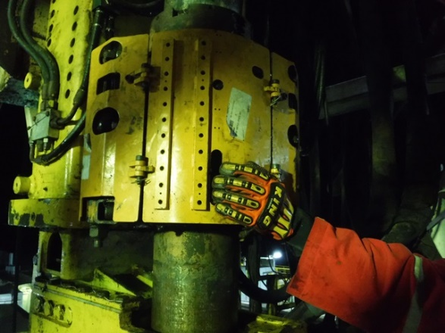
PDO Incident First Alert
Incident type | LTI (16)
Date/ time | 14.10.19@ 19:52hrs | Directorate
Location | Qarn Alam | Dept
What happened
During the function testing of IBOP, Floor man left hand fingers was caught in between the cover & actuator resulting in crush injuries.
Mr. Musleh asks the questions of can it happen to you?
Do you ensure all hazards are identified before performing the task?
Do keep your hands and fingers out of crush points?
Do you ensure energized equipment's are isolated during maintenance?
Do you ensure good communication and coordination with your colleagues?
Reconstruction only, equipment is isolated
Please disseminate this LTI notification to your teams and use it in your tool box talks and HSE meetings and notice boards.

