Slide 1
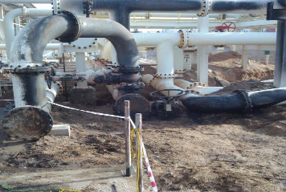
PDO Second Alert
Date: 17th January 2019 Incident: HiPo#02 Fire
What happened?
A contractor mechanical crew was engaged in removal of pipe supports as part of shutdown activities. While one of the crew members, a Fitter, started cutting the bolt of the pipe support a flash fire ignited and caused a burning pool fire in the near by (15 meters away) temporary drain pit. Nobody hurt in the incident. Emergency response was activated and the fire was doused by the fire tender.
Your learning from this incident..
Always comply with PTW requirements.
Identify and consider the hazards of flammable vapors from drain pits and plant leaks / spills when working in brown field areas.
While doing gas test ensure multiple spots around the work location are covered, i.e. at work height, ground level, lowest level etc.
During continuous gas monitoring ensure the position of gas monitor is changed frequently.
Photo explaining how it should be done right
Do not take short cuts, always comply with PTW

Slide 2
Management self audit
Date: 17th January 2019 Incident: HiPo#02 Fire
As a learning from this incident and ensure continual improvement all contract
managers must review their HSE HEMP against the questions asked below
Confirm the following:
Do you ensure that your crew members strictly follow PTW requirements and apply MOC when necessary?
Do you ensure proper interface and communication between different work groups during shutdown preparation and planning stage?
Do you consider presence of hydrocarbon drain pit/spill locations while applying for permits during shutdown activities?
Do you ensure gas tests are performed keeping the gas tester at various positions (work height, ground level and the lowest areas) and frequent change in position of the gas tester during continuous gas testing?
Do you ensure that open drain pits are back filled immediately after draining activities and before permit validation?
Do you ensure requirements identified from PSM challenge are implemented before starting shutdown activities?
Notes:
Make a list of closed questions (only ‘yes’ or ‘no’ as an answer) to ask other contractors if they have the same issues based on the management or HSE-MS failings or shortfalls identified in the investigation. Pretend you have to audit other companies to see if they could have the same issues.

