Slide 1
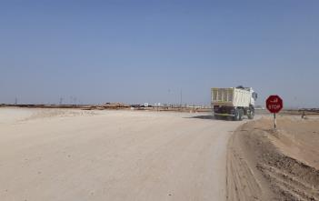
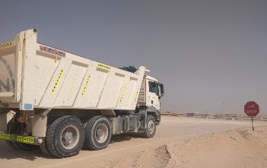
PDO Second Alert
Date: 24th February 2019 Incident title: MVI
What happened?
Hired tipper of the contracting company entered the T junction on the graded road without fully stopping at the STOP sign. Driver of the heavy bus (hired by another contractor) travelling on the main graded road with 11 passengers took evasive action to avoid collision with the Tipper. However the accident could not be prevented as the Tipper took immediate left turn to enter branch road without checking in the side mirror. This resulted in minor damages to both the vehicles. Drivers and passengers escaped unhurt.
Your learning from this incident..
Fully stop at the STOP sign.
Check traffic on both sides while entering from the T junction.
Reduce vehicle speed in accordance with the road conditions.
Obey road signages.
Give feedback regarding hazards on the road to the Journey Manager / Management.
Always contact PDO emergency number in case of incident.
Follow traffic rules, save your future
Notes:
Ensure all dates and titles are input
A short description should be provided without mentioning names of contractors or individuals. You should include, what happened, to who (by job title) and what injuries this resulted in. Nothing more!
Four to five bullet points highlighting the main findings from the investigation. Remember the target audience is the front line staff so this should be written in simple terms in a way that everyone can understand.
The strap line should be the main point you want to get across
The images should be self explanatory, what went wrong (if you create a reconstruction please ensure you do not put people at risk) and below how it should be done.

Slide 2
Management self audit
Date: 24th February 2019 Incident title: MVI
As a learning from this incident and ensure continual improvement all contract
managers must review their HSE HEMP against the questions asked below
Confirm the following:
Do you have programs to monitor and manage safe driving behavior of subcontractor / hired vehicles?
Do you ensure that the system is in place for the Drivers to inform hazards on the road and those are escalated for action at appropriate level?
Do you ensure that the employees are made aware of contacting PDO emergency number in case of accident / emergency situation and it is practiced through drills.
* If the answer is NO to any of the above questions please ensure you take action to correct this finding.
Notes:
Ensure all dates and titles are input
Make a list of closed questions (only ‘yes’ or ‘no’ as an answer) to ask others if they have the same issues based on the management or HSE-MS failings or shortfalls identified in the investigation.
Imagine you have to audit other companies to see if they could have the same issues.
These questions should start with: Do you ensure…………………?

