Slide 1
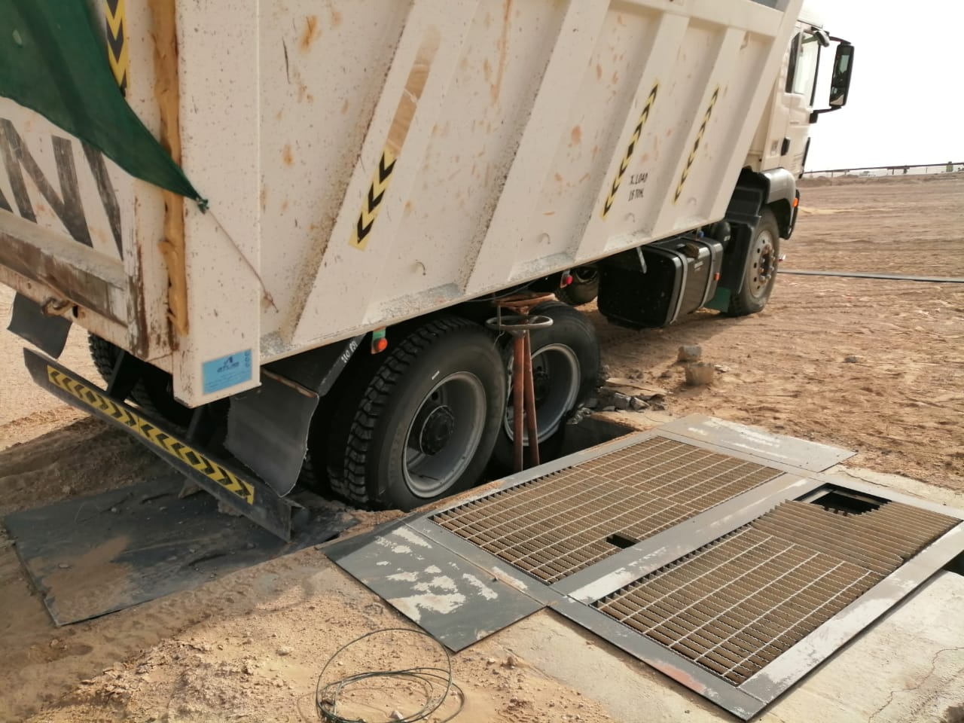
PDO Second Alert
Date: 7th March 2019 Incident: Work site MVI
What happened?
On 7th of March 2019 at around 07:36 am, a tipper truck driver entered a well pad area for the purpose of offloading back filling material (Soil) for the up coming hookup job, which is opposite to the well pad area that required soil for backfilling activity. During maneuvering between the live well head cellar pit and the dumped soil not realizing he was in front of the cellar pit, the right side rear tire of the tipper truck drove over the cellar grating, which resulted in breaking of the cellar grating, causing the truck to get stuck in the cellar pit
Your learning from this incident.
Always ensure you have permit to work to enter live well head area.
Always ensure you use a banksman
Always ensure the driver familiar about the location
Always ensure you have adequate supervision in place
Always ensure you have valid permit to work in the live well head area
Notes:
Ensure all dates and titles are input
A short description should be provided without mentioning names of contractors or individuals. You should include, what happened, to who (by job title) and what injuries this resulted in. Nothing more!
Four to five bullet points highlighting the main findings from the investigation. Remember the target audience is the front line staff so this should be written in simple terms in a way that everyone can understand.
The strap line should be the main point you want to get across
The images should be self explanatory, what went wrong (if you create a reconstruction please ensure you do not put people at risk) and below how it should be done.

Slide 2
Management self audit
Date: 7th March 2019 Incident: Work site MVI
As a learning from this incident and ensure continual improvement all contract
managers must review their HSE HEMP against the questions asked below
Confirm the following:
Do you ensure dedicated Banksman is attached to the tippers?
Do you ensure all activities are identified and performed under permit work system?
Do you ensure tippers movements into the vicinity / or in the well pad areas are identified and controlled?
Do you ensure face to face handover with joint site walkthroughs are conducted during supervisors movement/change from one site to another?
Do you ensure adequate supervisors are available as per the work load?
Do you ensure all newly joined Drivers/operators are being taken for site familiarization prior to deployment?
Notes:
Ensure all dates and titles are input
Make a list of closed questions (only ‘yes’ or ‘no’ as an answer) to ask others if they have the same issues based on the management or HSE-MS failings or shortfalls identified in the investigation.
Imagine you have to audit other companies to see if they could have the same issues.
These questions should start with: Do you ensure…………………?

