Slide 1
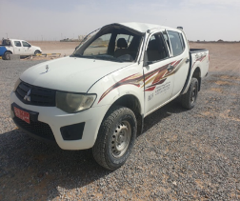

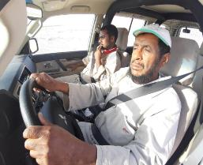

PDO Second Alert
Date: 11th March 2019 Incident: MVI
What happened?
On 11th March 2019 diriver lost control of his vehilce whilst travelling on a graded road due to a depression in the road, driver did not adapt his driving to road conditions
Your learning from this incident..
Ensure you check to see if the journey is really necessary?
Ensure you adjust your driving based on road conditions and environment conditions, use and implement proper defensive driving techniques.
Ensure that you report all Road Hazards to Journey Manager after each journey and ensure they are correctly logged and communicated to all drivers
Ensure that you are compliant with JM in accordance with SP 2000
Conditions change, So should your speed!
Notes:
Ensure all dates and titles are input
A short description should be provided without mentioning names of contractors or individuals. You should include, what happened, to who (by job title) and what injuries this resulted in. Nothing more!
Four to five bullet points highlighting the main findings from the investigation. Remember the target audience is the front line staff so this should be written in simple terms in a way that everyone can understand.
The strap line should be the main point you want to get across
The images should be self explanatory, what went wrong (if you create a reconstruction please ensure you do not put people at risk) and below how it should be done.

Slide 2
Management self audit
Date: 11th March 2019 Incident: MVI
As learned from this incident and to ensure continual improvement all
managers of the contract must review their HSE HEMP against the questions asked below
Confirm the following:
Do you ensure the Journey Manager properly communicated known road hazards to driver prior to journey?
Do you ensure road hazards reported to your JM / Supervisor?
Do you conduct effective audit of JM in accordance with SP 2000?
Do you ensure journey’s are being managed in compliance with SP 2000?
Do you ensure that the journey is absolutely necessary?
* If the answer is NO to any of the above questions please ensure you take action to correct this finding.
Notes:
Ensure all dates and titles are input
Make a list of closed questions (only ‘yes’ or ‘no’ as an answer) to ask others if they have the same issues based on the management or HSE-MS failings or shortfalls identified in the investigation.
Imagine you have to audit other companies to see if they could have the same issues.
These questions should start with: Do you ensure…………………?

