Slide 1
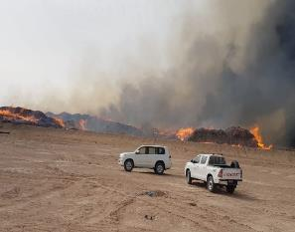
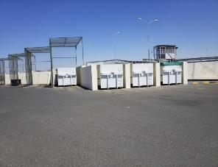
PDO Second Alert
Date: 21st March 2019 Incident: HiPo#13 Fire
What happened?
An unknown source ignited a fire in Qarn Alam waste yard. The fire rapidly spread across the yard with prevailing winds igniting other hazardous and non hazardous waste, causing environmental impact to the area
Your learning from this incident..
Always segregate waste into the different waste streams and controlled by a physical means
Always ensure that you are familiar with the local emergency plan
Always ensure that you have the right fire equipment available to extinguishing a fire
Always ensure that ignition source is controlled in high risk flammable areas
Always ensure that you are familiar with the hazards and risks in your workplace
Segregate & Minimize your Waste at Source
Notes:
Ensure all dates and titles are input
A short description should be provided without mentioning names of contractors or individuals. You should include, what happened, to who (by job title) and what injuries this resulted in. Nothing more!
Four to five bullet points highlighting the main findings from the investigation. Remember the target audience is the front line staff so this should be written in simple terms in a way that everyone can understand.
The strap line should be the main point you want to get across
The images should be self explanatory, what went wrong (if you create a reconstruction please ensure you do not put people at risk) and below how it should be done.

Slide 2
Management self audit
Date: 21st March 2019 Incident: HiPo#13 Fire
As a learning from this incident and ensure continual improvement all contract
managers must review their HSE HEMP against the questions asked below
Confirm the following:
Do you ensure that you have an adequate Waste Strategy Plan in place?
Do you ensure that hazardous and non hazardous waste is segregate at source?
Do you ensure that operatives are fully conversant with the requirements for segregating waste at source?
Do you ensure hazardous and non hazardous waste scope is fully understood?
Do you ensure that you have the correct environmental permits in place for the stored waste?
Do you ensure that you follow the correct waste management policies and procedures including legislated?
Do you ensure that suitable and sufficient assurance audits are carried out?
Do you ensure that an adequate contracts are in place with your subcontractor or 3rd party, and is it communicated to all parties working in the same vacinity?
Do you ensure that your management and subcontractor teams follow recommendations from audits and incident investigation reports to completion?
Do you ensure the application of Management of Change when condition change?
* If the answer is NO to any of the above questions please ensure you take action to correct this finding.
Notes:
Ensure all dates and titles are input
Make a list of closed questions (only ‘yes’ or ‘no’ as an answer) to ask others if they have the same issues based on the management or HSE-MS failings or shortfalls identified in the investigation.
Imagine you have to audit other companies to see if they could have the same issues.
These questions should start with: Do you ensure…………………?

