Slide 1
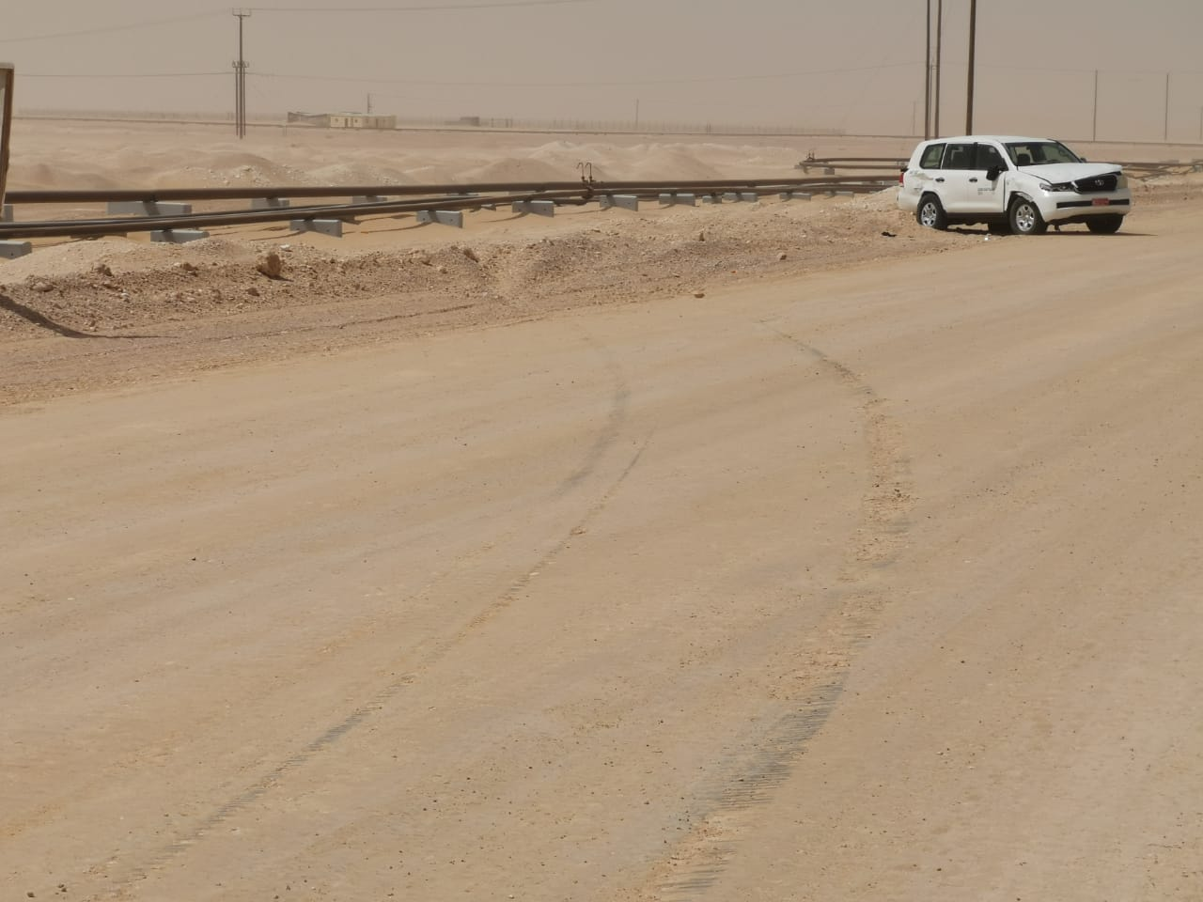
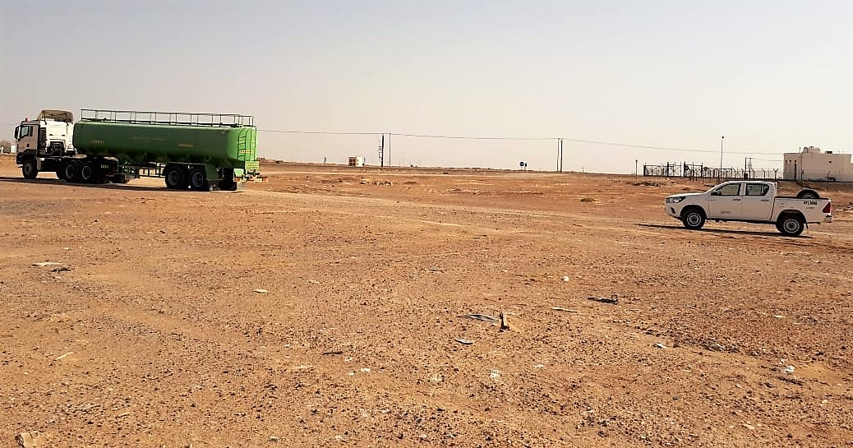
PDO Second Alert
Date: 25th Mar 2019 Incident: HiPo#14, MVI
What happened?
On 25th March 2019 at around 8:20am while the crew was travelling in a Land Cruiser from Camp to Site on the graded road they saw a truck travelling in the front. When they reached close to the truck, they noticed that the truck is reducing its speed. The Operator (driver) of Land Cruiser decided to overtake the truck assuming that the truck was going to stop. While overtaking suddenly the truck head moved to the left as the driver of the truck intended to turn left at the junction. To avoid colliding with the truck head the driver of land cruiser took a sharp turn to the left. When he turned left he saw the pipelines so he took another sharp turn to the right, he was able to avoid colliding with the truck head and pipelines the land cruiser lost control and rollover (360 degree).
Your learning from this incident..
Do not overtake in sharp bends or any road junctions.
Maintain appropriate speed while overtaking.
Be aware of road hazards including reaction of other road users.
Use your empowerment to stop any unsafe driving behavior.
Apply 4 second techniques to maintain safe distance.
Stay away from dust cloud.
Do not overtake if unsafe.
Notes:
Ensure all dates and titles are input
A short description should be provided without mentioning names of contractors or individuals. You should include, what happened, to who (by job title) and what injuries this resulted in. Nothing more!
Four to five bullet points highlighting the main findings from the investigation. Remember the target audience is the front line staff so this should be written in simple terms in a way that everyone can understand.
The strap line should be the main point you want to get across
The images should be self explanatory, what went wrong (if you create a reconstruction please ensure you do not put people at risk) and below how it should be done.

Slide 2
Management self audit
Date: 25th Mar 2019 Incident: HiPo#14, MVI
As a learning from this incident and ensure continual improvement all contract
managers must review their HSE HEMP against the questions asked below
Confirm the following:
Do you ensure that SJMS is effectively implemented?
Do you ensure that SJMS is audited according to Road Safety Standards?
Do you ensure that drivers are engaged and educated about all road safety matters?
Do you ensure that drivers behavior is monitored?
Does your annual HSE plan include awareness sessions with regards to road safety?
Do you ensure that driving hazards including are captured in MOC process?
Do you ensure that undedicated drivers are monitored & included in your Awareness sessions?
* If the answer is NO to any of the above questions please ensure you take action to correct this finding.
Notes:
Ensure all dates and titles are input
Make a list of closed questions (only ‘yes’ or ‘no’ as an answer) to ask others if they have the same issues based on the management or HSE-MS failings or shortfalls identified in the investigation.
Imagine you have to audit other companies to see if they could have the same issues.
These questions should start with: Do you ensure…………………?

