Slide 1
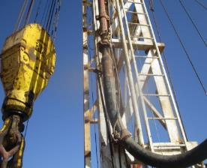
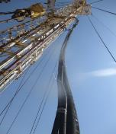
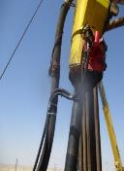
PDO Second Alert
Date: 31st March 2019 Incident title :HIPo#16
What happened?
Operation was drilling 8 ½ section, while picking up the Kelly to connect the second joint, the air hose of Kelly spinner double-way manifold assembly (weight 10kg) became caught on one of the standpipe vibrator hose clamps at the mast leg. As the driller has not seen this entanglement, he continued hoisting up. As a result of this, the hose became under tension at 13 meters height. The hose stretched to the maximum level and by back force, the manifold dragged, broke from its plate at welding point and dropped down on rig floor in the off driller side near rotary table. Zone management was maintained on the rig floor at the time of incident.
Your learning from this incident.
Always consider right method of secondary retention and verify during inspection.
Always secure properly all loose hoses after the rig move and before spud.
Ensure that pre spud inspections checklists are fit for purpose.
Rig floor crew must be vigilant and pay attention to traveling equipment in rig floor.
Air hose caught point
✓
Air hose Secured
Always look up when hoisting the Kelly
Notes:
Ensure all dates and titles are input
A short description should be provided without mentioning names of contractors or individuals. You should include, what happened, to who (by job title) and what injuries this resulted in. Nothing more!
Four to five bullet points highlighting the main findings from the investigation. Remember the target audience is the front line staff so this should be written in simple terms in a way that everyone can understand.
The strap line should be the main point you want to get across
The images should be self explanatory, what went wrong (if you create a reconstruction please ensure you do not put people at risk) and below how it should be done.

Slide 2
Management self audit
Date: 31st March 2019 Incident title :HIPo#16
As a learning from this incident and ensure continual improvement all contract
managers must review the HSE HEMP against the questions asked below
Confirm the following:
Do you ensure your DROPS inspection checklist cover all potential DROPS objects and identifies the correct primary and secondary securing method for each item?
Do you ensure your team members are familiar with the DROPS primary and secondary securing for all potential DROPS.
Do you ensure that the DROPS surveyor is competent enough to carry out a thorough and proficient DROPS inspection.
Do you ensure your crew members use the hazard identification and assessment tools properly and meaningfully?
Notes:
Make a list of closed questions (only ‘yes’ or ‘no’ as an answer) to ask other contractors if they have the same issues based on the management or HSE-MS failings or shortfalls identified in the investigation. Pretend you have to audit other companies to see if they could have the same issues.

