Slide 1
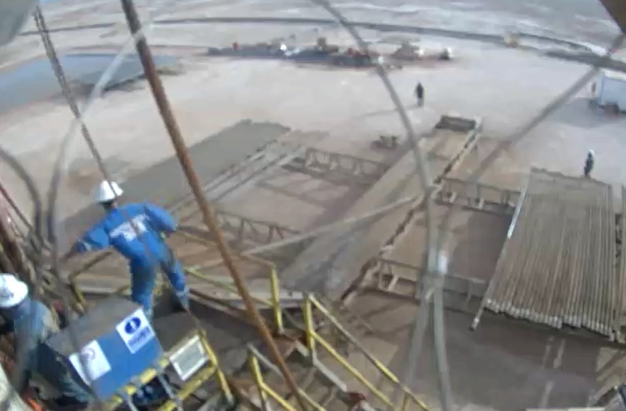
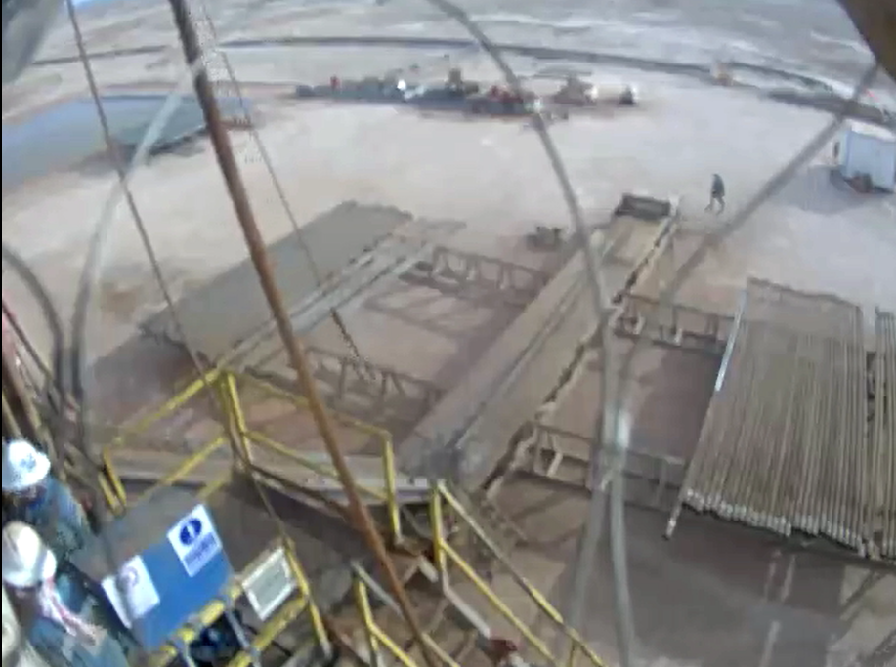
PDO Second Alert
Date: 26th March 2019 Incident title :HIPo#15
What happened?
At approximately 17:00 hours on 26th of March 2019, the crew was picking up 4” heavy weight drill pipe from the catwalk to the Rig floor. Winch line was connected to the drill pipe which was centralized in the catwalk walk. When the floor man executed the lift by operating the winch, the drill pipe slid off the catwalk and dropped in to the ground approximately 1 meter. There were nobody in the vicinity of the catwalk.
Your learning from this incident..
Supervisors to ensure task hazards are identified and explained to the crew members.
Always winch operator should pay attention while pick up /laydown pipe
Always maintain good communication while operating winch .
Ensure supervisors are providing effective supervision during critical weather conditions.
Discuss all hazards in the TBT including weather conditions.
Always respect the zone management
Exercise empowerment to STOP unsafe work if the work condition is not safe.
Zone management save lives', Comply
Notes:
Ensure all dates and titles are input
A short description should be provided without mentioning names of contractors or individuals. You should include, what happened, to who (by job title) and what injuries this resulted in. Nothing more!
Four to five bullet points highlighting the main findings from the investigation. Remember the target audience is the front line staff so this should be written in simple terms in a way that everyone can understand.
The strap line should be the main point you want to get across
The images should be self explanatory, what went wrong (if you create a reconstruction please ensure you do not put people at risk) and below how it should be done.

Slide 2
Management self audit
Date: 26th March 2019 Incident title :HIPo#16
As a learning from this incident and ensure continual improvement all contract
managers must review their HSE HEMP against the questions asked below
Confirm the following:
Do you ensure that your crew is aware of company’s empowerment to STOP policy?
Do you ensure that your crew discuss environmental hazards in the TBT?
Do you ensure that you Strictly adhere to DROP zone management?
Do you ensure your site supervisors, supervised critical operations activates?
Do you ensure HEMP is up to date and identifying weather hazards?
Do you ensure MOC applied for unusual conditions?
* If the answer is NO to any of the above questions please ensure you take action to correct this finding.
Notes:
Ensure all dates and titles are input
Make a list of closed questions (only ‘yes’ or ‘no’ as an answer) to ask others if they have the same issues based on the management or HSE-MS failings or shortfalls identified in the investigation.
Imagine you have to audit other companies to see if they could have the same issues.
These questions should start with: Do you ensure…………………?

