Slide 1
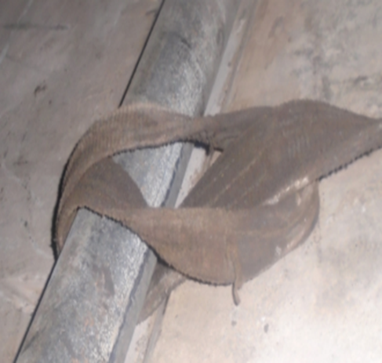
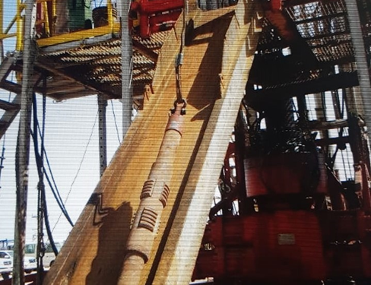
PDO Second Alert
Date: 17th March 2019 Incident title: HiPo#17
What happened?
While laying down 7 inch scraper by using winch and web sling by applying single wrap on the scraper. As a result scraper slipped from web sling and slide down through V door to the catwalk and landed at the end of the catwalk. At the time of incident no one was in no go zone area.
Your learning from this incident..
Always plan the job and identify and arrange the right equipment's
Always follow the procedure and do not take shortcut
Supervisors shall always supervise the task
Always keep away from red zone
Always use lifting cap while lifting slick BHA components
Notes:
Ensure all dates and titles are input
A short description should be provided without mentioning names of contractors or individuals. You should include, what happened, to who (by job title) and what injuries this resulted in. Nothing more!
Four to five bullet points highlighting the main findings from the investigation. Remember the target audience is the front line staff so this should be written in simple terms in a way that everyone can understand.
The strap line should be the main point you want to get across
The images should be self explanatory, what went wrong (if you create a reconstruction please ensure you do not put people at risk) and below how it should be done.

Slide 2
Management self audit
Date: 17th March 2019 Incident title: HiPo#17
As a learning from this incident and ensure continual improvement all contract
managers must review their HSE HEMP against the questions asked below
Confirm the following:
Do you ensure crew implemented learning from previous incidents?
Do your ensure supervisors plan the job and identify required equipment to avoid shortcuts?
Do you ensure Empowerment to STOP to any unsafe job will be implemented in the work area?
Do you ensure that all tasks are completely supervised and supervisors do not involve themselves in the tasks?
* If the answer is NO to any of the above questions please ensure you take action to correct this finding.
Notes:
Ensure all dates and titles are input
Make a list of closed questions (only ‘yes’ or ‘no’ as an answer) to ask others if they have the same issues based on the management or HSE-MS failings or shortfalls identified in the investigation.
Imagine you have to audit other companies to see if they could have the same issues.
These questions should start with: Do you ensure…………………?

