Slide 1
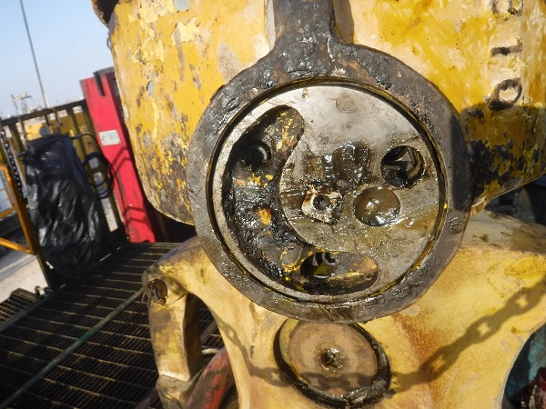
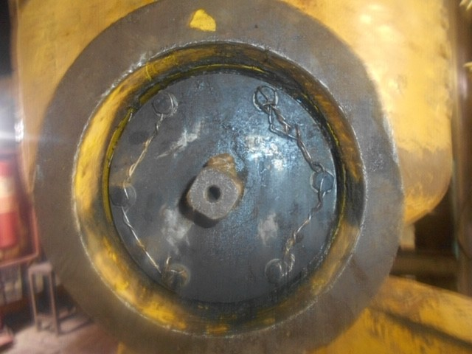

PDO Second Alert
Date: 28th March 2019 Incident: HiPo #18
What happened?
After jarring, during RIH 2.7/8” CMT stinger, rotating lock (around 2.5 kg) on the travelling block fell down (10 m height) to the rig floor. All employees were out of the red zone during the time of the incident.
Your learning from this incident..
Always include rotation lock in the DROPS inspection checklist and carryout detailed DROPS inspection after jarring operation.
Always install secondary retentions on the rotating lock.
Always ensure that not more than 3 bolts are lock wired together and span between bolts not exceeding 15 cms.
Always follow the recommendation from the OEM while defining the maintenance frequency.
Ensure secondary retention on all potential DROPS objects
Notes:
Ensure all dates and titles are input
A short description should be provided without mentioning names of contractors or individuals. You should include, what happened, to who (by job title) and what injuries this resulted in. Nothing more!
Four to five bullet points highlighting the main findings from the investigation. Remember the target audience is the front line staff so this should be written in simple terms in a way that everyone can understand.
The strap line should be the main point you want to get across
The images should be self explanatory, what went wrong (if you create a reconstruction please ensure you do not put people at risk) and below how it should be done.

Slide 2
Management self audit
Date: 28th March 2019 Incident: HiPo #18
As a learning from this incident and ensure continual improvement all contract
managers must review their HSE HEMP against the questions asked below
Confirm the following:
Do you periodically review the DROPS checklist
Do you carryout DROPS inspection after jarring or other heavy activities
Do you ensure that the OEM recommendations are captured in the PMS
Do you ensure DROPS requirements are defined in the technical specification during procurement of the equipment.
Do you ensure all Safety Critical Equipment are maintained as per OEM recommendations.
* If the answer is NO to any of the above questions please ensure you take action to correct this finding.
Notes:
Ensure all dates and titles are input
Make a list of closed questions (only ‘yes’ or ‘no’ as an answer) to ask others if they have the same issues based on the management or HSE-MS failings or shortfalls identified in the investigation.
Imagine you have to audit other companies to see if they could have the same issues.
These questions should start with: Do you ensure…………………?

