Slide 1
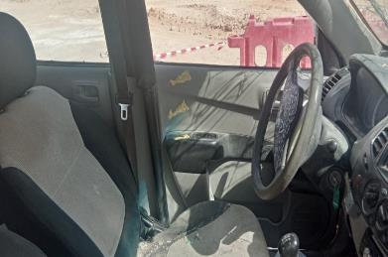
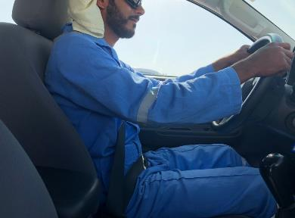
PDO Second Alert
Date: 31st March 2019 HiPo # 19 MVI
Improper position of seat and driving at high speed.
What happened?
The driver was proceeding from Camp in a Pickup towards East RMS. At approx. 14:18 hrs driver entered in to a barricaded newly constructed asphalt road (segment 1 of asphalt road from Yibal to YKP) which was yet to be opened for road users. As there were road blockades the driver decided to take the left shoulder to by pass them . While he was trying to re-enter to the black top, he over steered to the right and lost control resulting in a “S” pattern on the asphalt road and rolled over on the right side shoulder.
Learning from this incident..
Do not use any unapproved roads.
Obey signage and barricades provided.
Reduce speed while changing from different road conditions (Tarmac to Graded Roads).
Maintain correct posture and seating position while driving.
Over speeding contributes to accidents .
✖
✔
Do not use unapproved Roads
Maintain speed limits and follow correct seating position and posture while driving
Notes:
Ensure all dates and titles are input
A short description should be provided without mentioning names of contractors or individuals. You should include, what happened, to who (by job title) and what injuries this resulted in. Nothing more!
Four to five bullet points highlighting the main findings from the investigation. Remember the target audience is the front line staff so this should be written in simple terms in a way that everyone can understand.
The strap line should be the main point you want to get across
The images should be self explanatory, what went wrong (if you create a reconstruction please ensure you do not put people at risk) and below how it should be done.

Slide 2
Management self audit
Date: 31st March 2019 HiPo # 19 MVI
As a learning from this incident and ensure continual improvement all contract
managers must review their HSE HEMP against the questions asked below
Confirm the following:
Do you ensure periodic checks for IVMS System for its integrity?
Do you ensure the competency on the basis of Performance evaluation?
Do you ensure that your IVMS Coordinators are competent?
Do you ensure that you are applying LSR consequence management effectively?
Are you ensuring your drivers are using project approved routes only?
Are you using only project approved roads?
Do you ensure your drivers are maintaining correct posture while driving?
Notes:
Ensure all dates and titles are input
Make a list of closed questions (only ‘yes’ or ‘no’ as an answer) to ask others if they have the same issues based on the management or HSE-MS failings or shortfalls identified in the investigation.
Imagine you have to audit other companies to see if they could have the same issues.
These questions should start with: Do you ensure…………………?

