Slide 1
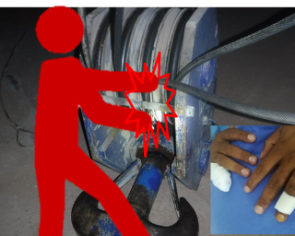
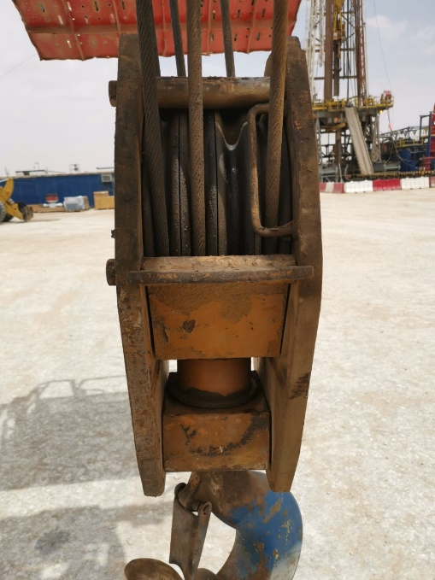
PDO Second Alert
Date: 15th February 2019 Incident : Finger injury
What happened?
Crane operator attempted to release the stack wire-rope using both of his hands, while the crane hook block was still above ground level, hence crane wire-rope was under tension. The stuck wire-rope suddenly released crushing the operator’s right little finger between the line and block sheave.
Your learning from this incident..
Always keep your hands/fingers away from crush points and ensure understanding the risk of stored energy .
Always follow proper maintenance and troubleshooting procedures.
All personnel are obliged to STOP when intervened for unsafe act, .
Always ensure effective TBT with clear roles & responsibilities for all involved.
Always ensure the lift plan is in place for high risk activity
Never place your hands between the line and sheave
Notes:
Ensure all dates and titles are input
A short description should be provided without mentioning names of contractors or individuals. You should include, what happened, to who (by job title) and what injuries this resulted in. Nothing more!
Four to five bullet points highlighting the main findings from the investigation. Remember the target audience is the front line staff so this should be written in simple terms in a way that everyone can understand.
The strap line should be the main point you want to get across
The images should be self explanatory, what went wrong (if you create a reconstruction please ensure you do not put people at risk) and below how it should be done.

Slide 2
Management self audit
Date: 15th February 2019 Incident : Finger injury
As a learning from this incident and ensure continual improvement all contract
managers must review their HSE HEMP against the questions asked below
Confirm the following:
Do you ensure that all personnel are provided with clear Roles & Responsibilities (for crane operation & breakdown)?
Do you ensure that your training matrix includes Hands & Fingers injury prevention and BBS training as minimum competency requirements?
Do you ensure that TBT is effective and all risks are communicated to all parties involved?
Do you ensure adequate level of supervision during site activities?
Do you ensure lift plans are in place for lifting activities?
Does your assurance process identifies & captures the gaps?
Do you ensure interface management with 3rd parties is in place, communicated and understood?
* If the answer is NO to any of the above questions please ensure you take action to correct this finding.
Notes:
Ensure all dates and titles are input
Make a list of closed questions (only ‘yes’ or ‘no’ as an answer) to ask others if they have the same issues based on the management or HSE-MS failings or shortfalls identified in the investigation.
Imagine you have to audit other companies to see if they could have the same issues.
These questions should start with: Do you ensure…………………?

