Slide 1
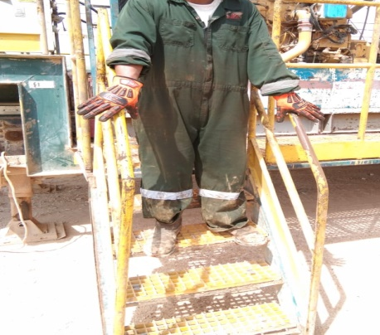
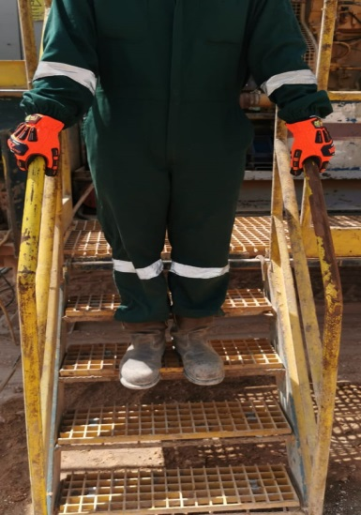
PDO Second Alert
Date: 28th August 2019 Incident title: LTI
What happened?
The Roustabout was descending from mud pump trailer through the generator side stair, got slipped from stair steps and fell on the ground resulting fracture in his left hand wrist.
Your learning from this incident..
Ensure the handrail and steps are clean and tidy.
Ensure the fiber grating connecting clamps are fixed and tightened properly.
Ensure that the impact gloves are clean prior to use.
Walk slow and steady while climbing or descending from the stairs.
Ensure the “Use of handrails” signage is provided for all stairs / ladders
Ensure house rules are being discussed and crew aware about it.
Always hold the handrails while climbing or descending from the stairs.
Notes:
Ensure all dates and titles are input
A short description should be provided without mentioning names of contractors or individuals. You should include, what happened, to who (by job title) and what injuries this resulted in. Nothing more!
Four to five bullet points highlighting the main findings from the investigation. Remember the target audience is the front line staff so this should be written in simple terms in a way that everyone can understand.
The strap line should be the main point you want to get across
The images should be self explanatory, what went wrong (if you create a reconstruction please ensure you do not put people at risk) and below how it should be done.

Slide 2
Management self audit
Date: 28th August 2019 Incident title: LTI
As a learning from this incident and ensure continual improvement all contract
managers must review their HSE HEMP against the questions asked below
Confirm the following:
Do you ensure inspection/checks /maintenance in Place for gratings (walkway, stairs, handrails)?
Do you ensure that all employee are aware and following house rules?
Do you ensure that HEMP is being used and discussed during TBT’s?
Do you ensure that all hazards has been captured during site inspections and Audits?
Do you ensure that effective assurance process in place during management site visits?
Do you ensure that all access/egress areas are posted with “Use of handrails” sign?
Do you ensure that you have safe access and egress?
If the answer is NO to any of the above questions please ensure you take action to correct this finding.
Notes:
Ensure all dates and titles are input
Make a list of closed questions (only ‘yes’ or ‘no’ as an answer) to ask others if they have the same issues based on the management or HSE-MS failings or shortfalls identified in the investigation.
Imagine you have to audit other companies to see if they could have the same issues.
These questions should start with: Do you ensure…………………?

