Slide 1
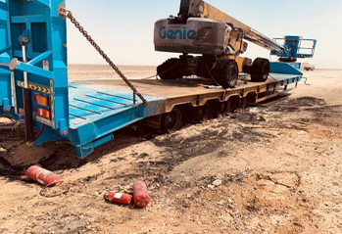
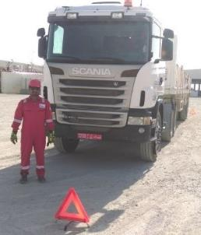
PDO Second Alert
Date: 19th July2019 Incident: LTI#13
What happened?
While transporting a man lift onto a lowboy, the driver observed that the truck was dragging and there was clutch/brake smell. He stopped the vehicle and proceeded to check the condition of truck and trailer. Whilst checking around the vehicle, at the rear right side, the last right tire burst and caught fire. Driver felt some debris on his face and his left eye. He attempted to put out the fire using fire extinguishers, without success, fire were not controlled resulting in damage in the low bed trailer tires and in the man lift unit. ROP arrived at scene and immediately contact the fire brigade at Qarn Alam and extinguished the fire. The driver was taken to Ghaba Clinic, initial treatment was washing his left eye with solution. He was referred to Nizwa hospital for further evaluation.
Your learning from this incident..
Safety glasses must be worn whilst inspecting the vehicle
Always ensure the pre-post inspection checklist is perform properly
Heavy Vehicle Brake air test must be always conducted prior to start a journey
Don’t attempt to fight a fire if it is unsafe to do so
Ensure you call PDO emergency services on 5555 for any emergency
Always wear your PPE when inspecting the vehicle
Notes:
Ensure all dates and titles are input
A short description should be provided without mentioning names of contractors or individuals. You should include, what happened, to who (by job title) and what injuries this resulted in. Nothing more!
Four to five bullet points highlighting the main findings from the investigation. Remember the target audience is the front line staff so this should be written in simple terms in a way that everyone can understand.
The strap line should be the main point you want to get across
The images should be self explanatory, what went wrong (if you create a reconstruction please ensure you do not put people at risk) and below how it should be done.

Slide 2
Management self audit
Date: 19th July2019 Incident: LTI#13
As a learning from this incident and ensure continual improvement all contract
managers must review their HSE HEMP against the questions asked below
Confirm the following:
Do you ensure heavy vehicle Pre-trip inspection checklist covers the requirement to do full air brakes check before trip starts?
Do you ensure that your competency requirements for heavy vehicles’ drivers covers the skill to perform a full air brakes daily checks?
Do you ensure that your transportation vendors/contractors audit assess the level of quality of their Preventive Maintenance?
Do ensure that emergency drill scenarios are conducted with drivers to ensure they understand what to do in a vehicle fault or in emergency situation?
Do you ensure that your preventive maintenance system defines a clear procedure for different maintenance levels intervals, the components to be checked, and criteria for acceptance/non-acceptance of these components
* If the answer is NO to any of the above questions please ensure you take action to correct this finding.
Notes:
Ensure all dates and titles are input
Make a list of closed questions (only ‘yes’ or ‘no’ as an answer) to ask others if they have the same issues based on the management or HSE-MS failings or shortfalls identified in the investigation.
Imagine you have to audit other companies to see if they could have the same issues.
These questions should start with: Do you ensure…………………?

