Slide 1
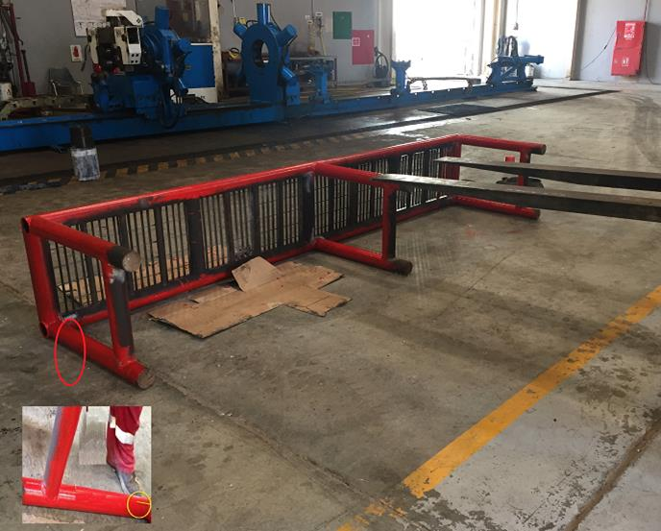
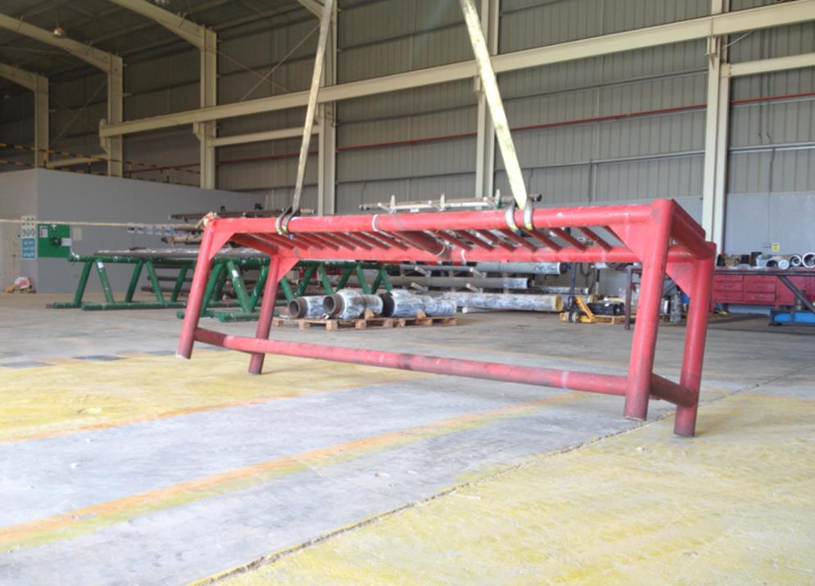
PDO Second Alert
Date: 27.11.2016 Incident title : LTI / Nimr
What happened?
The technician was painting the inspection tool rack weighing approximately 280 kg.
To enable him to paint underneath the rack. The 3rd party Forklift operator tilted the
rack partially with the Forklift. At this point the technician and the third party Forklift
operator positioned themselves on opposite side of the rack and lowered it manually
the remaining distance to the ground. During this process the tool rack landed on the
Forklift operator’s left foot.
Your learning from this incident..
Always use mechanical handling aids when carrying out a heavy lift.
Always stop to identify the hazard of the operations before starting work.
Always report to the supervisor all the operational task of the day during the
operational TBT.
Always intervene and stop unsafe act even if your involved in the task.
Wrong manual handling for the inspection tool rack
Always use mechanical handling aids when carrying out a heavy lift
Proper position of inspection tool rack for painting

Slide 2
Management self audit
Date: 27.11.2016 Incident title : LTI / Nimr
As a learning from this incident and ensure continual improvement all contract
managers must review their HSE HEMP against the questions asked below
Confirm the following:
Do you have controls in place to segregate what is routine an non-routine tasks?
Do you have adequate processes to encourage and convince employees of the importance of stop work authority?
Do you have specific job descriptions issued to your Forklift Operators?
Notes:
Make a list of closed questions (only ‘yes’ or ‘no’ as an answer) to ask other contractors if they have the same issues based on the management or HSE-MS failings or shortfalls identified in the investigation. Pretend you have to audit other companies to see if they could have the same issues.

