Slide 1
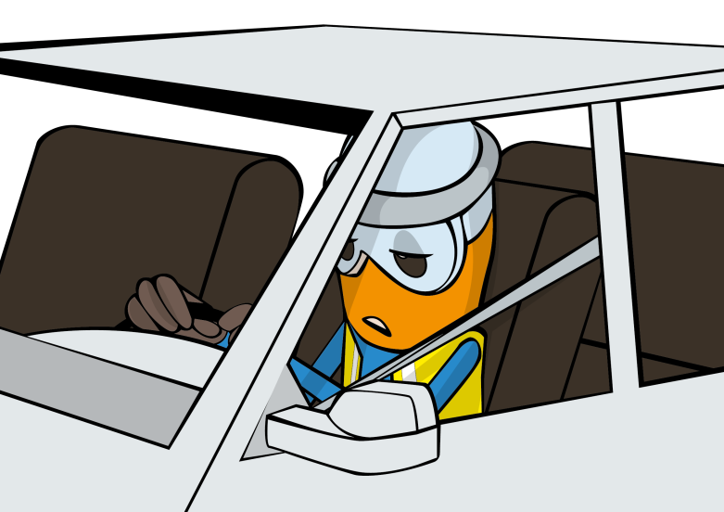
PDO Second Alert
Date: 18.12.2016 Incident title: MVI LTI
What happened?
Al Hassan Pick-up was traveling from Harweel to Fahud, approximately 39km from Nimr roundabout the pick-up crossed the carriageway into the path of an Omani Truck Owner (OTO) prime mover travelling from Haima to Nimr. The OTO driver attempted to avoid the collision by steering to the right, however the pick-up crossed into the oncoming traffic lane and collided with the prime movers front left wheel area.
Your learning from this incident..
Ensure you take adequate rest during long trips and if you feel fatigued, take a break.
Always ensure you have an approved safety journey plan (SJP)
Agree with passengers before the trip to assist in monitoring the drivers behaviour
Understand your responsibilities in SJP
Take regular breaks when driving long distances

Slide 2
Management self audit
Date: 18.12.2016 Incident title: MVI LTI
As a learning from this incident and ensure continual improvement all contract
managers must review their HSE HEMP against the questions asked below
Confirm the following:
Have you conducted your 6 monthly audits for SJM?
Do you conduct periodic driver forums?
Do you conduct spot check on drivers and vehicles?
Do you ensure compliance with SP-2000 and L.S.R?
Do you ensure all SJP are authorised by the correct authority?
Notes:
Make a list of closed questions (only ‘yes’ or ‘no’ as an answer) to ask other contractors if they have the same issues based on the management or HSE-MS failings or shortfalls identified in the investigation. Pretend you have to audit other companies to see if they could have the same issues.

