Slide 1
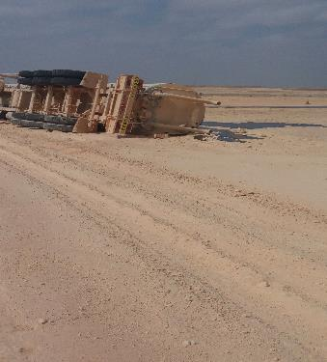
PDO Second Alert
Date: 23.11.2017 Incident title: HiPo MVI
What happened
After collecting 50m³ from a well site the driver of the Crude tanker lost control of his vehicle whilst on route to Amal west pumping station. The vehicle left the road for unknown reasons to the right shoulder down a gradient. When the driver attempted to bring the vehicle back onto the road the tanker has tipped over to the right side coming to rest part on the shoulder and part on the road. The driver received minor injuries and crude was spilled from the top hatches and vent.
Your learning from this incident..
Never Driver above the designated speed limits.
Always stay alert for unplanned events.
Always drive to the road conditions
Always maintain the correct road position after negotiating a junction
Always follow Defensive Driving Techniques

Slide 2
Management self audit
Date: 23.11.2017 Incident title: HiPo MVI
As a learning from this incident and ensure continual improvement all contract
managers must review their HSE HEMP against the questions asked below
Confirm the following:
Do you ensure that you activities are planned?
Do you ensure that your HEMP is communicated to your crew?
Do you ensure that SOPs are communicated and followed?
Do you ensure adequate process of implementation of permit to work systems?
Notes:
Make a list of closed questions (only ‘yes’ or ‘no’ as an answer) to ask other contractors if they have the same issues based on the management or HSE-MS failings or shortfalls identified in the investigation. Pretend you have to audit other companies to see if they could have the same issues.

