Slide 1
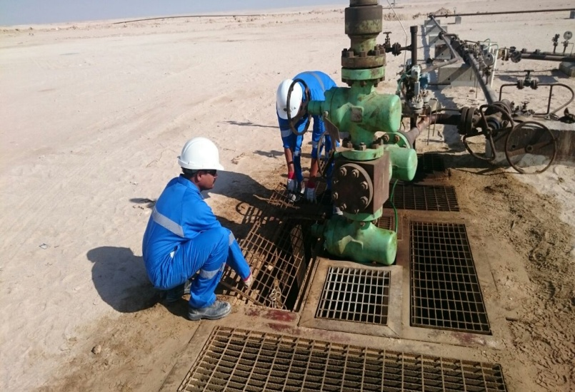
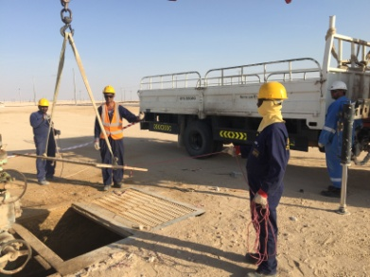
PDO Second Alert
Photo explaining what was done wrong
Date: 27.10.2016 PDO - LTI # 37
What happened?
A PDO Operator along with his assistant was to operate a valve on casing which was at a depth of 1.2 meter from the ground level for re-commissioning of the well. While removing a section of the grating frame, the assistant operator stepped on an unstable frame, lost his balance and fell forward into the cellar which is 2.4 meter deep. As a result of falling the assistant sustained head injury (Trauma). Operator called Bahja operations for rescue support. Meanwhile he managed to get support from the nearby Well Pulling Hoist to rescue him from the cellar. Later on he was medevac to Haima hospital by PDO ambulance for further treatment.
Your learning from this incident..
Use proper equipment to removal heavy structure (i.e. cellar grating frames)
TBT for every job no matter it is routine or a simple job
Don’t be complacent in routine jobs
Photo explaining how it should be done right
No Removal of cellar frames by hands

Slide 2
Management self audit
Date: 27.10.2016 PDO – LTI #37
As a learning from this incident and ensure continual improvement all contract
managers must review their HSE HEMP against the questions asked below
Confirm the following:
Do you have appropriate competency procedure for your workforce? e.g. work instruction to reopen a well after well Work over's.
Do your HEMP (TRIC) contains all Hazards & Controls associated with the task?
Are all personnel involved in the assigned activity briefed with Hazards and Controls?
Do your operators evaluate the risks prior to the commencement of their tasks?
Are your operator s have sufficient & appropriate resources to perform a given task safely?
Notes:
Make a list of closed questions (only ‘yes’ or ‘no’ as an answer) to ask other contractors if they have the same issues based on the management or HSE-MS failings or shortfalls identified in the investigation. Pretend you have to audit other companies to see if they could have the same issues.

