Slide 1
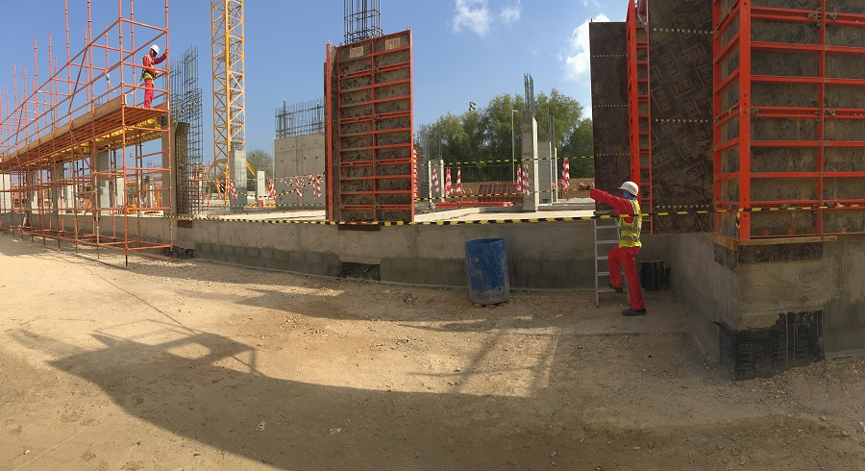
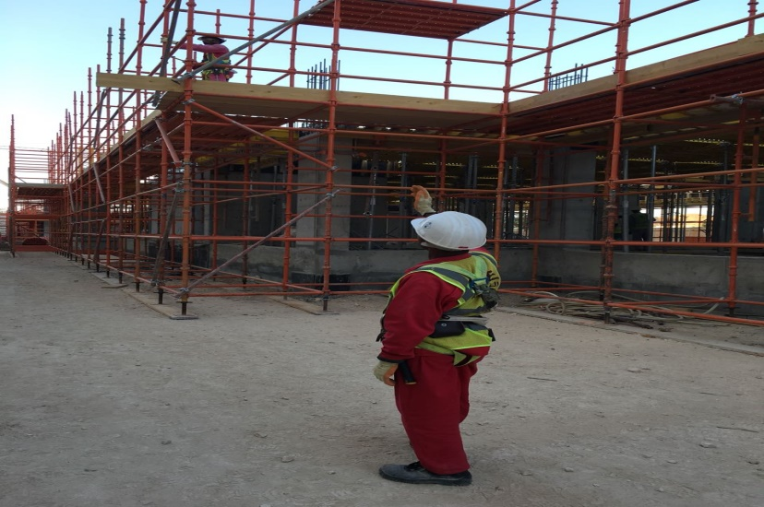
PDO Second Alert
Date: 04.11.2017 Incident: LTI
What happened?
The scaffolder was engaged in scaffold erection activities, meanwhile he was standing on the ground and guiding the alignment of the scaffold. While doing so he placed his right foot on a step ladder which was stacked adjacent to the plinth beam. The ladder slipped and he lost his balance and fell on to the ground fracturing his upper left arm.
Your learning from this incident..
Always watch your footing
Always ensure equipment is properly used.
Pay attention to your footing
Stable platform

Slide 2
Management self audit
Date: 04.11.2017 Incident: LTI
As a learning from this incident and ensure continual improvement all contract
managers must review their HSE HEMP against the questions asked below
Confirm the following:
Do you ensure that the training and hazard hunt modules be enhanced to improve behaviors relating to complacency, lack of concentration etc.?
Do you ensure that TBTs remind workers about maintaining constant awareness of hazards and the use of appropriate equipment or tools?
Do you consider complacency as a risk factor for your workforce during routine activities?
Do you ensure that people are adequately communicated of worksite hazards and risks?
Do you ensure that tools possess a risk always and alerted people about this risk?
Do you ensure that supervisors have a vigilance on unsafe acts and conditions?
Notes:
Make a list of closed questions (only ‘yes’ or ‘no’ as an answer) to ask other contractors if they have the same issues based on the management or HSE-MS failings or shortfalls identified in the investigation. Pretend you have to audit other companies to see if they could have the same issues.

