Slide 1
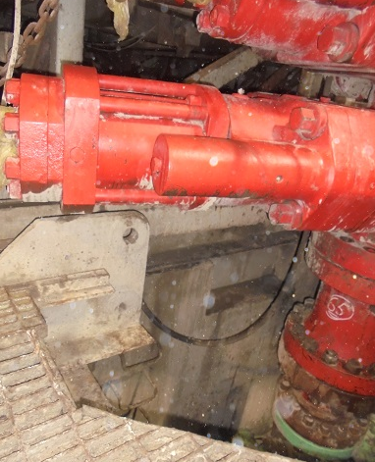
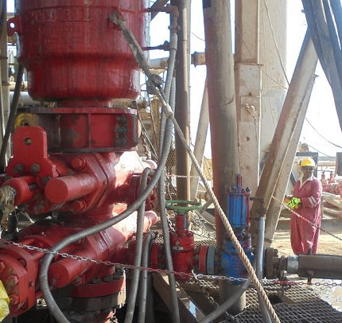
PDO Second Alert
Date: 03.10.16 Incident title: LTI
What happened?
The task was to prepare nipple down BOP. After unscrewing all the BOP nuts and studs, the Floorman-1 was coming out from the cellar, holding the pad eye of the substructure lower beam. At the same time, the Floor man-2 unintentionally operated off Driller’s side (ODS) BOP hoisting winch which resulted in the tilting of BOP from one end. Consequently the Floorman-1’s right hand thumb finger got trapped in between the pad eye and BOP shear ram bonnet.
Your learning from this incident..
Ensure you follow the procedures/instructions of your immediate Supervisor.
Identify all the hazards, assess the risks and controls prior to all tasks.
Intervene if the task is performed unsafely or if the instructions are not being followed.
Isolate equipment/ winch controls after use & keep the equipment winch control in its designated safe place.
Ensure the BOP winch operation controls are carried out only by the crew after receiving adequate training and assessment, to perform the task in a safe manner.
FLM used the pad eye to hold while coming out of the cellar through the ladder
Trained/Competent person should only operate winch
Isolate BOP winch controls after its use
Ensure winch operations control is given only to trained, competent & authorized person

Slide 2
Management self audit
Date: 03.10.16 Incident title: LTI
As a learning from this incident and ensure continual improvement all contract
managers must review their HSE HEMP against the questions asked below
Confirm the following:
Do you have a system to ensure that all the learning from previous incidents are implemented?
Are your BOP winch operators trained / assessed and competent to operate it safely?
Do your employees carry out interventions?
Notes:
Make a list of closed questions (only ‘yes’ or ‘no’ as an answer) to ask other contractors if they have the same issues based on the management or HSE-MS failings or shortfalls identified in the investigation. Pretend you have to audit other companies to see if they could have the same issues.

