Slide 1
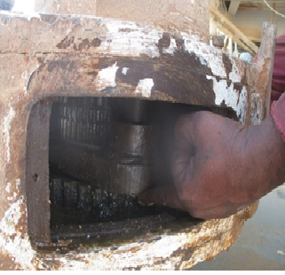
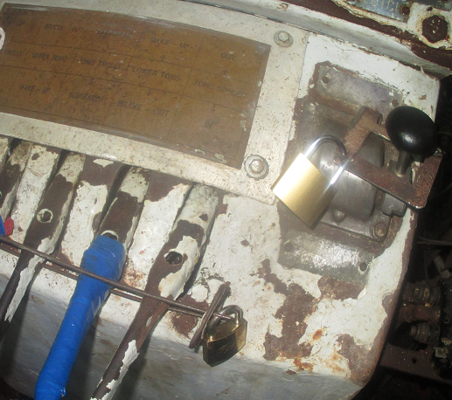
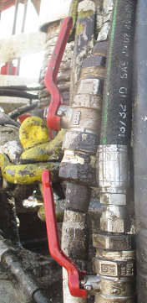
PDO Second Alert
Date: 10.11.2016 Incident title : Finger Injury (LTI)
What happened?
The Mechanic wanted to check the retaining nut and gave signal to stop, during the function testing of the Farr Tong gear shifter after repairs. However, the mechanic did not wait for confirmation of his signal while it was operating and put his hand into the gear shifter of the tongs, resulting in crush injury, to his left hand middle finger.
Your learning from this incident..
Always ensure equipment is adequately isolated before start of work.
Apply the 4 Golden questions for Hands & Fingers safety.
Ensure effective communication between the work group involved, prior to the start of any service/ repairs.
Keep away your hands/ fingers from any equipment with potential to cause injury.
Use hands free tools wherever possible.
Ensure the isolation is function tested
Mechanic used his hand to check the nut before ensuring isolation of the equipment
Pneumatic isolations of Farr tong
Always ensure energised equipment is isolated
Always ensure the equipment is isolated before working on it

Slide 2
Management self audit
Date:10.11.2016 Incident title :Finger Injury (LTI)
As a learning from this incident and ensure continual improvement all contract
managers must review their HSE HEMP against the questions asked below
Confirm the following:
Do you ensure adequate supervision is maintained at all times?
Do you ensure effective isolation is performed prior to start of a specific task involving repairs/ service/ function tests?
Do you ensure effective communication is maintained with all personnel involved ?
Are all your tasks performed using Hands free tools where possible?
Notes:
Make a list of closed questions (only ‘yes’ or ‘no’ as an answer) to ask other contractors if they have the same issues based on the management or HSE-MS failings or shortfalls identified in the investigation. Pretend you have to audit other companies to see if they could have the same issues.

