Slide 1
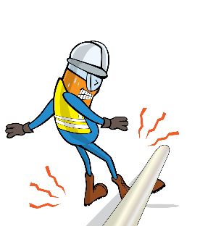
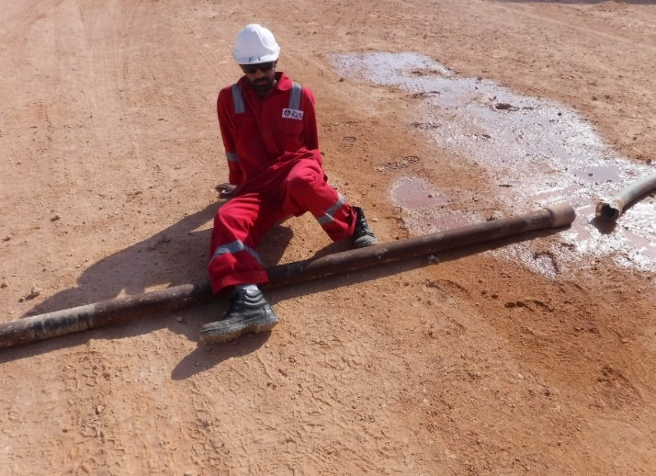


PDO Incident First Alert
Incident type | LTI (#17)
Date/ time | 03.11.2019 at 23:30hrs. | Directorate
Location | Karim Small Fields (Nimr) | Dept
What happened
While a trailer was passing over a pipeline, the crane operator placed his foot on top of the pipe in an attempt to steady it. As the trailer moved the pipe struck his leg resulting in a fracture to his right leg.
Mr. Musleh asks the questions of can it happen to you?
Do you communicate with the other parties you are working with?
Do you ensure you are stood in a safe place?
Do you always consider if you are in the ‘line of fire’?
Please disseminate this LTI notification to your teams and use it in your tool box talks and HSE meetings and notice boards.

