Slide 1
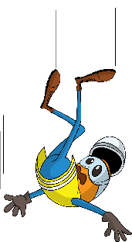
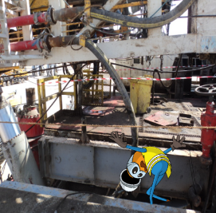


PDO Incident First Alert
Incident type | LTI (#18)
Date/ time | 01.11.2019 at 22:00hrs. | Directorate
Location | Qarn Alam area | Dept
What happened
While a Floorman was trying to secure stand pipe for rig move, he fell from rig floor to sub base resulting in fracture to his right wrist.
Mr. Musleh asks the questions of can it happen to you?
Do you ensure you identify all hazards before starting a task?
Do you ensure you are in a safe position while performing a task?
Do you consider if you can fall from height?
Floorman fell into the subbase
Please disseminate this LTI notification to your teams and use it in your tool box talks and HSE meetings and notice boards.

