Slide 1
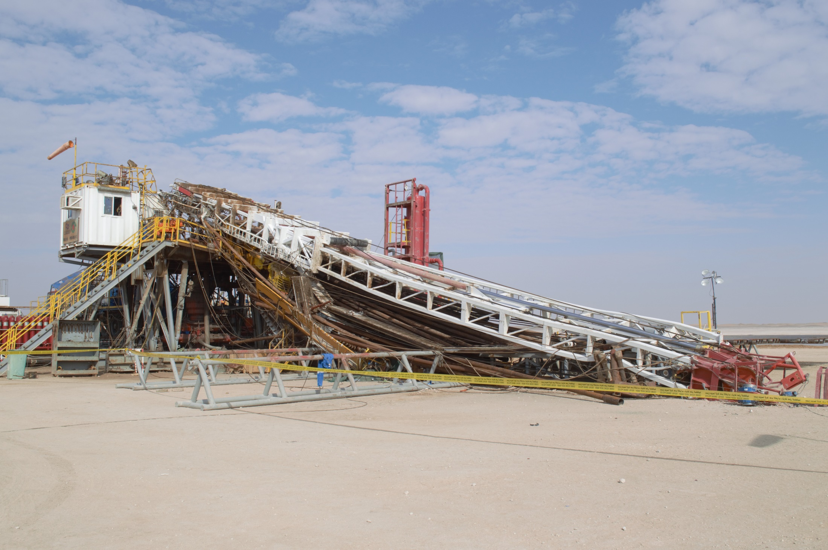
Safety Alert
Use this Alert: Discuss in Tool Box Talks and HSE Meetings ➔ Distribute to contractors ➔ Post on HSE Notice Boards ➔ Include in site HSE Induction
Targeted audience: Wells
Mast Collapse
What happened?
On the 5th December 2019 at @16:30hrs while pulling out of hole after reverse circulation excess cement, the Driller commenced pulling out of hole with variable pipe rams of the Blow out Preventer in the closed position. When the tool joint hit the pipe ram the entire mast, including pipe stands collapsed towards the catwalk area. The Derrickman was killed and 3 other crewmen were injured.
Things to check:
How do you know the structure is able to withstand multiple shock impacts?
How do you ensure the tension of the supporting guy lines are measured as per Original Equipment Manufacturer (OEM) recommendations?
How do you know that the Blow out Preventer status is checked prior to commencing pulling out of hole?
Do you know the weakest point on the hoisting system/structure design and the operating envelope?
How do you know that procedures are clear, available, current, and workable?
How do you ensure that people are out of the line of fire during such operations?
“This document is restricted and it is distributed for information purposes only and it shall not be shared with other than PDO employees and contracts without PDO permission”.

