Slide 1
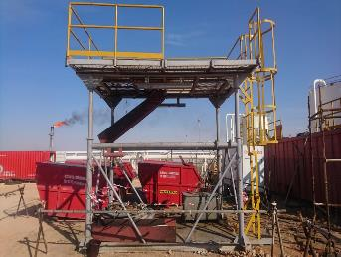

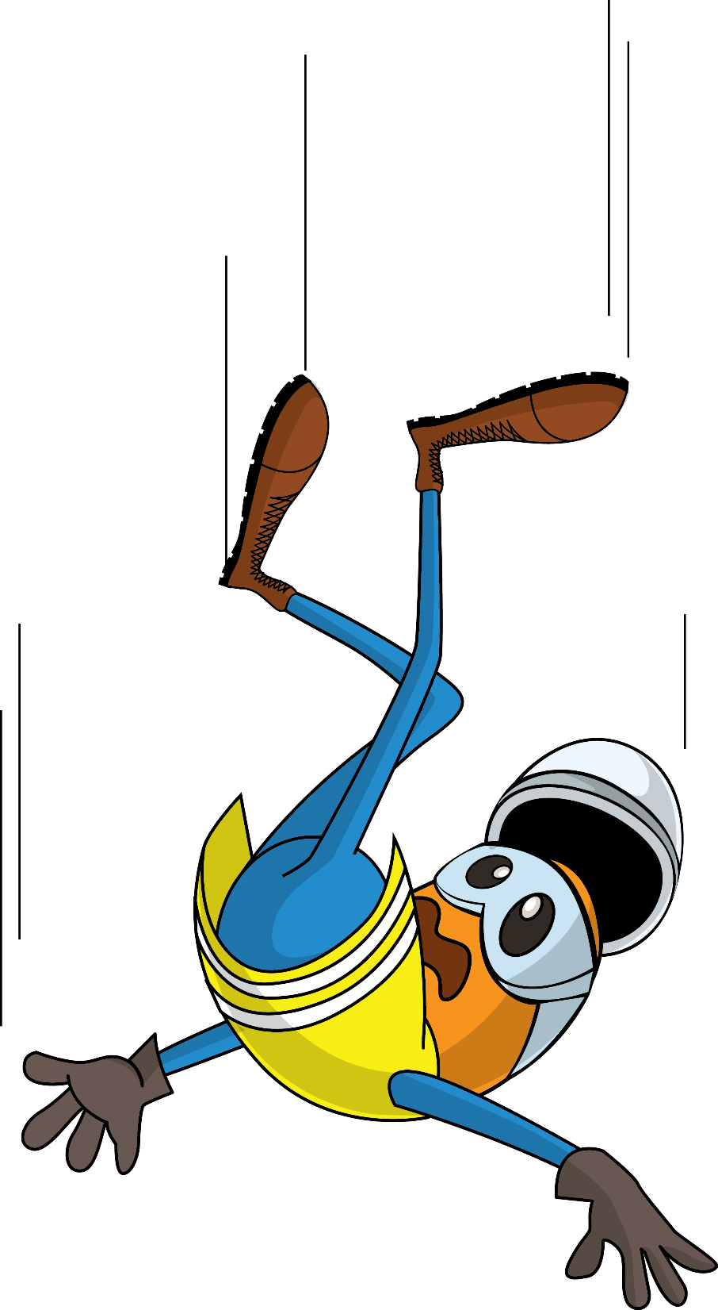
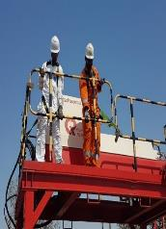
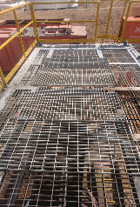
PDO Second Alert
Date: 4th April 2019 Incident: HiPo#21
What happened?
A subcontractor employee climbed on the platform for demolition of platform used for desludging of the tank using a centrifuge telescopic skid. The platform had an opening where the skid was placed, which was exposed once the skid was removed. The technician step back while removing the handrail and fell down from a height of ~ 3.5 m through the hole to the platform floor..
Your learning from this incident.
Do you thoroughly review risk assessment and control of subcontractor activities?
Do you confirm primary/secondary fall protections are in place for working at height?
Do you ensure 100% tie off while working at height?
Do you identify the potential hazard of drops in your activities?
Practice safety at a height, to prevent a drastic fright.
Notes:
Ensure all dates and titles are input
A short description should be provided without mentioning names of contractors or individuals. You should include, what happened, to who (by job title) and what injuries this resulted in. Nothing more!
Four to five bullet points highlighting the main findings from the investigation. Remember the target audience is the front line staff so this should be written in simple terms in a way that everyone can understand.
The strap line should be the main point you want to get across
The images should be self explanatory, what went wrong (if you create a reconstruction please ensure you do not put people at risk) and below how it should be done.

Slide 2
Management self audit
Date: 4th April 2019 Incident: HiPo#21
As a learning from this incident and ensure continual improvement all contract
managers must review their HSE HEMP against the questions asked below
Confirm the following:
Do you ensure risk assessment cover all the activates happening at your site?
Do you identify the potential risk of fall in your activities?
Do you ensure sufficient number of employees are assigned for manual handling job?
Do you check competence of the manpower deployed by the subcontractors?
Do you activate emergency procedure as and when any emergency happened at your work?
Do you ensure effective supervision for critical activities.
Notes:
Ensure all dates and titles are input
Make a list of closed questions (only ‘yes’ or ‘no’ as an answer) to ask others if they have the same issues based on the management or HSE-MS failings or shortfalls identified in the investigation.
Imagine you have to audit other companies to see if they could have the same issues.
These questions should start with: Do you ensure…………………?

