Slide 1
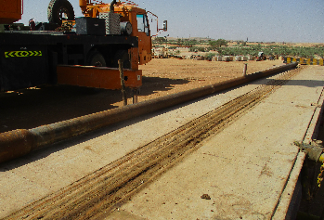
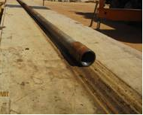
PDO Second Alert
Date: 24th March 2019 Incident: HiPo#22 Drops
What happened?
During Drilling of top hole section the driller was lifting the 5“ Drill pipe (DP) by 5-ton winch from catwalk to rig floor through the V-door when the DP slipped from the end of the catwalk, hanging on the winch line and swung towards substructure & contacted the outer side of the sub base vertical support stand .
No injury / equipment damaged resulted in event .
Your learning from this incident.
Ensure that drill pipe is properly placed in the Catwalk before lifting
Always be away from line of fire and maintain drop zone
Always stop the work if tools or equipment are not properly placed before being lifted
Always stick to the roles and responsibilities stated in the Toolbox Talk.
Always ensure the Drill pipe is fully inserted on the catwalk groove before being lifted to the rig floor
Notes:
Ensure all dates and titles are input
A short description should be provided without mentioning names of contractors or individuals. You should include, what happened, to who (by job title) and what injuries this resulted in. Nothing more!
Four to five bullet points highlighting the main findings from the investigation. Remember the target audience is the front line staff so this should be written in simple terms in a way that everyone can understand.
The strap line should be the main point you want to get across
The images should be self explanatory, what went wrong (if you create a reconstruction please ensure you do not put people at risk) and below how it should be done.

Slide 2
Management self audit
Date: 24th March 2019 Incident: HiPo#22 Drops
As a learning from this incident and ensure continual improvement all contract
managers must review their HSE HEMP against the questions asked below
Confirm the following:
Do you ensure that your Team Leaders at site are reviewing the CCTV and intervening when required?
Do you ensure that all key personnel are effectively participating in STOP system?
Do you ensure that all HSE responsibilities for key personnel are clearly described in Job description?
Do you ensure that HSE responsibilities stated in their job description are executed?
Do you ensure that competency program is efficient and effectively followed?
* If the answer is NO to any of the above questions please ensure you take action to correct this finding.
Notes:
Ensure all dates and titles are input
Make a list of closed questions (only ‘yes’ or ‘no’ as an answer) to ask others if they have the same issues based on the management or HSE-MS failings or shortfalls identified in the investigation.
Imagine you have to audit other companies to see if they could have the same issues.
These questions should start with: Do you ensure…………………?

