Slide 1
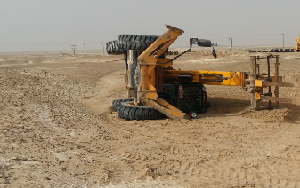
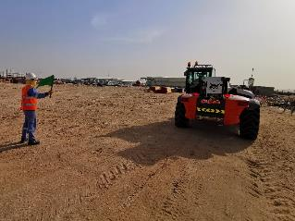
PDO Second Alert
Date: 25th April 2019 Incident: HiPo#25
What happened?
A sub contractor’s telehandler tipped over while reversing on an elevated and inclined plane. After off loading one foundation, the banksman gave signal to reverse the equipment and park near an inclined and elevated area. While the banksman was busy on other activities, telehandler operator decided to straighten the wheels by moving the equipment in reverse. When he moved the equipment on an inclined plane with raised boom, the center of gravity of the equipment moved and the equipment tipped over to left side resulting crush injury to operator’s left little finger.
Your learning from this incident.
Always operate mobile equipment only under instruction of a Banksman
While driving heavy equipment on an inclined plane, always follow recommended control measures
Always ensure stability of an equipment during operation by understanding location of its center of gravity
Always use a banksman while operating a mobile equipment

Slide 2
Management self audit
Date: 25th April 2019 Incident: HiPo#25
As a learning from this incident and ensure continual improvement all contract
managers must review their HSE HEMP against the questions asked below
Confirm the following:
Do you ensure competency checks for sub contractor employees deployed on critical tasks ?
Do you ensure operation of heavy equipment and Vehicles only in presence of banksman at your locations?
Do you ensure the TBTs are interactive and covers all relevant hazards for the tasks in hand ?
Do you ensure site visits and inspections focus on compliance to critical safety requirements like competency and communication?
Notes:
Make a list of closed questions (only ‘yes’ or ‘no’ as an answer) to ask other contractors if they have the same issues based on the management or HSE-MS failings or shortfalls identified in the investigation. Pretend you have to audit other companies to see if they could have the same issues.

