Slide 1
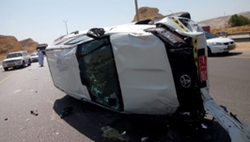
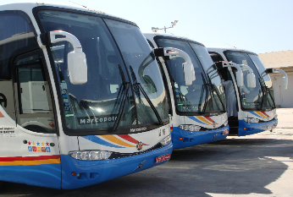
PDO Second Alert
Date: 1st April 2019 Incident: HiPo#26
What happened?
On 1st of April, driver started trip from Muscat to Kauther 8. While driving on the express highway after the airport bridge and towards Batinah, a third party vehicle got very close to the vehicle from driver’s side. The driver while looking at the car sliding towards him, immediately honked horn to warn the other vehicle of the situation. After hearing the horn, the third party driver steered hard to the left then to the right hitting the vehicle on left side. the driver tried to avoid the collision by steering hard right, causing him to hit the cement barrier on the shoulder of the road and loose control of the vehicle causing roll over.
Your learning from this incident..
Avoid use of light vehicle for commuting crews on distances beyond 200 km.
Compliance with SP-2000 requirements for commuting personnel is mandatory.
Use of approved PDO bus reduces the risks of motor vehicle incidents for distances beyond 200 km.
It’s proven it safer to use PDO approved bus
Notes:
Ensure all dates and titles are input
A short description should be provided without mentioning names of contractors or individuals. You should include, what happened, to who (by job title) and what injuries this resulted in. Nothing more!
Four to five bullet points highlighting the main findings from the investigation. Remember the target audience is the front line staff so this should be written in simple terms in a way that everyone can understand.
The strap line should be the main point you want to get across
The images should be self explanatory, what went wrong (if you create a reconstruction please ensure you do not put people at risk) and below how it should be done.

Slide 2
Management self audit
Date: 1st April 2019 Incident: HiPo#26
As a learning from this incident and ensure continual improvement all contract
managers must review their HSE HEMP against the questions asked below
Confirm the following:
Do you ensure training sessions are periodically done to create awareness on defensive driving?
Do you ensure to assess driver’s skills on a regular basis?
Do you ensure to coach new drivers and assess their performance and driving behaviors?
Do you ensure to review and discuss external road hazards with your drivers periodically?
Do you ensure to promote benefits of defensive driving vs. aggressive driving?
Do you ensure compliance with SP2000?
* If the answer is NO to any of the above questions please ensure you take action to correct this finding.
Notes:
Ensure all dates and titles are input
Make a list of closed questions (only ‘yes’ or ‘no’ as an answer) to ask others if they have the same issues based on the management or HSE-MS failings or shortfalls identified in the investigation.
Imagine you have to audit other companies to see if they could have the same issues.
These questions should start with: Do you ensure…………………?

