Slide 1
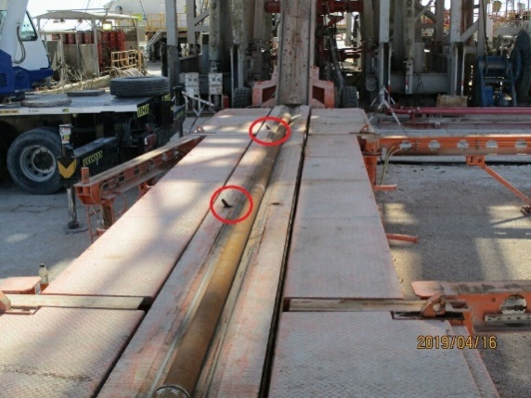
PDO Safety Alert
Date: 13th April 2019 Incident title: HiPo#27
What happened?
At around 15:52 the operation was to P/U drill pipes using the power catwalk in order to prepare DP stands for the next section. The driller was on the brake and the mud tester was operating the power catwalk. The drill pipe joint was rolled from the pipe rack to the power catwalk using catwalk kicker. The mud tester did not notice that the drill pipe pin end rolled beyond the catwalk groove. Accordingly, when the power catwalk was raise up to around 2m, the drill pipe fell down. No-go zone was clear of people and nobody got hurt.
Your learning from this incident.
Only authorized person should be assigned to operate the equipment.
Always assign tasks to a designated person.
Ensure power catwalk pipe stoppers are working at all times during P/U and L/D of tubular.
Always intervene the unsafe act whenever you see it
Do not operate power catwalk if you are not authorized!
Notes:
Ensure all dates and titles are input
A short description should be provided without mentioning names of contractors or individuals. You should include, what happened, to who (by job title) and what injuries this resulted in. Nothing more!
Four to five bullet points highlighting the main findings from the investigation. Remember the target audience is the front line staff so this should be written in simple terms in a way that everyone can understand.
The strap line should be the main point you want to get across
The images should be self explanatory, what went wrong (if you create a reconstruction please ensure you do not put people at risk) and below how it should be done.

Slide 2
Management self audit
Date: 13th April 2019 Incident title: HiPo#27
As a learning from this incident and ensure continual improvement all contract
managers must review their HSE HEMP against the questions asked below
Confirm the following:
Do you ensure that your equipment is only operated by authorized person?
Do you ensure your maintenance team take immediate action on this situation and communicate to all staff?
Do you ensure that your safety device of your equipment is in reliable and good condition?
Do you ensure that the HEMP is implemented and all controls have been allocated with roles and responsibilities?
Do you ensure your supervisors give priority to safety?
Do you ensure previous incident are shared and lessons are taken?
* If the answer is NO to any of the above questions please ensure you take action to correct this finding.
Notes:
Ensure all dates and titles are input
Make a list of closed questions (only ‘yes’ or ‘no’ as an answer) to ask others if they have the same issues based on the management or HSE-MS failings or shortfalls identified in the investigation.
Imagine you have to audit other companies to see if they could have the same issues.
These questions should start with: Do you ensure…………………?

