Slide 1
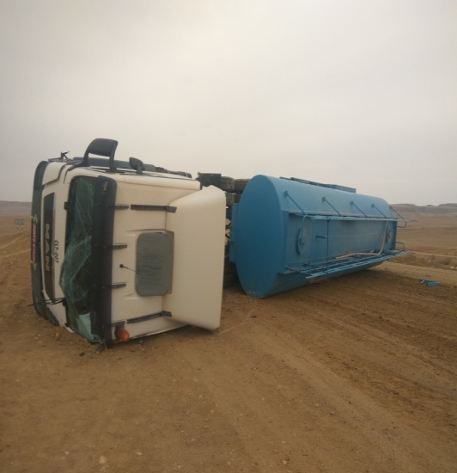
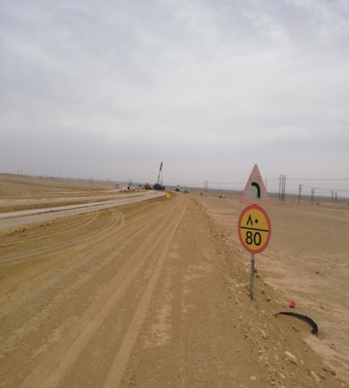
PDO Second Alert
Date: 13th April 2019 Incident: HiPo#30
What happened?
On 13th of April 2019 around 06:45 hrs a subcontractor 8000 gallon water tanker started journey from Rig site to Fahud RO plant to fill water. Approximately 08:00 hrs as the water tanker approached near Fahud scrap yard, prior to reaching a slight curve the driver lost control of the water tanker resulting in tipped over on the driver side across the road. The driver and the passenger both escaped without injury.
Your learning from this incident..
Always follow Defensive Driving Techniques
Drive to an appropriate speed for the road condition
The sign posted speed limit may not always to be the safe speed limit
Prevailing weather changes must communicate to SJM and drivers
Drive according to road condition and adjust your speed
Notes:
Ensure all dates and titles are input
A short description should be provided without mentioning names of contractors or individuals. You should include, what happened, to who (by job title) and what injuries this resulted in. Nothing more!
Four to five bullet points highlighting the main findings from the investigation. Remember the target audience is the front line staff so this should be written in simple terms in a way that everyone can understand.
The strap line should be the main point you want to get across
The images should be self explanatory, what went wrong (if you create a reconstruction please ensure you do not put people at risk) and below how it should be done.

Slide 2
Management self audit
Date: 13th April 2019 Incident: HiPo#30
As a learning from this incident and ensure continual improvement all contract
managers must review their HSE HEMP against the questions asked below
Confirm the following:
Do you ensure 24 hrs IVMS monitoring of your vehicles?
Do you manage your Sub contractors HSE?
Are you regularly monitoring the IVMS reports of your sub contractors drivers and vehicles?
Do you ensure your drivers follow defensive driving techniques on the graded road ?
Do you ensure your Sub-contractor IVMS system is included in PDO Main IVMS system ?
* If the answer is NO to any of the above questions please ensure you take action to correct this finding.
Notes:
Ensure all dates and titles are input
Make a list of closed questions (only ‘yes’ or ‘no’ as an answer) to ask others if they have the same issues based on the management or HSE-MS failings or shortfalls identified in the investigation.
Imagine you have to audit other companies to see if they could have the same issues.
These questions should start with: Do you ensure…………………?

