Slide 1
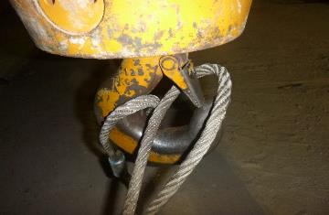
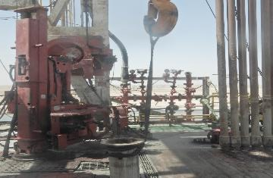
PDO Second Alert
Date: 26th April 2019 Incident Title: HiPo#32
What happened?
The operation was to rig down the mouse hole in preparation to nipple down 21.1/4” BOP. The mouse hole was lifted in vertical position by crane using wire rope sling. While lowering the mouse hole to the ground, the sling slacked as the mouse hole touched the ground. One sling eye rotated enabling the safety latch to open and the eye came out of the hook. The mouse hole (650 kg) dropped to the ground from a height of around 6m. No injuries occurred.
Your learning from this incident..
Never use sling to lift mouse hole. Lifting belt” webbing sling to be used”.
Always follow lifting & Hoisting OEM recommendations.
Ensure to follow 10 questions for safe lift.
Ensure your lifting supervisors are trained in lifting courses as required
Always use the approved lifting gear for the operation
Notes:
Ensure all dates and titles are input
A short description should be provided without mentioning names of contractors or individuals. You should include, what happened, to who (by job title) and what injuries this resulted in. Nothing more!
Four to five bullet points highlighting the main findings from the investigation. Remember the target audience is the front line staff so this should be written in simple terms in a way that everyone can understand.
The strap line should be the main point you want to get across
The images should be self explanatory, what went wrong (if you create a reconstruction please ensure you do not put people at risk) and below how it should be done.

Slide 2
Management self audit
Date: 26th April 2019 Incident Title: HiPo#32
As a learning from this incident and ensure continual improvement all contract
managers must review their HSE HEMP against the questions asked below
Confirm the following:
Do you ensure correct lifting accessories are used for the activity performed as per OEM recommendations?
Do you ensure that procedures provided are effectively implemented?
Do you ensure your lifting & hoisting are carried out by competent staff, ie trained lifting supervisor, riggers and banksman.
* If the answer is NO to any of the above questions please ensure you take action to correct this finding.
Notes:
Ensure all dates and titles are input
Make a list of closed questions (only ‘yes’ or ‘no’ as an answer) to ask others if they have the same issues based on the management or HSE-MS failings or shortfalls identified in the investigation.
Imagine you have to audit other companies to see if they could have the same issues.
These questions should start with: Do you ensure…………………?

