Slide 1
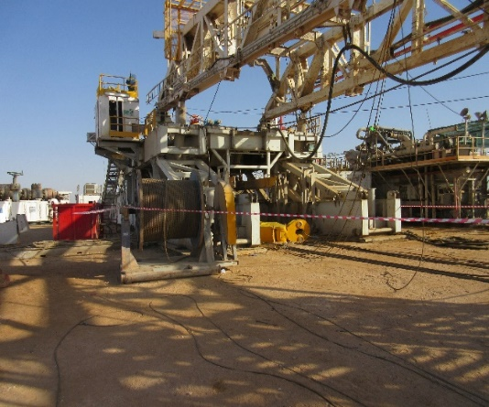

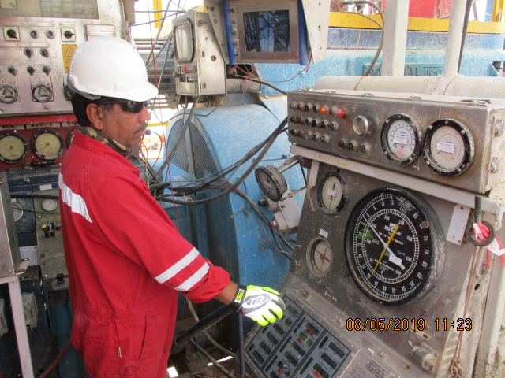

PDO Second Alert
Date: 1st May 2019 Incident Title: HiPo#33
What happened?
Prior to raising the mast, the traveling block was secured with rig floor shoe by means of a chain sling. Later, the mast was raised 1 meter off the stand and rig team waited for few minutes to confirm whether mast raising cylinder was holding. After being satisfied the cylinder was holding they decided to continue raising it. The mast was further raised up to four meters, the chain sling to be in tension resulting in the sling parting. Due to drill line pull, the block slid from rig floor and landed on the ground from a height of 5.10 meters. No injury happened NO GO was established.
Your learning from this incident.
Always ensure close supervision to be assigned to all tasks based on their criticality
Always Use certified and fit for purpose lifting equipment's.
Always ensure that all hazards must be captured in Control of work i.e WI, TRIC , JSA etc.
Always ensure that Control of Work must be verified by base supervisor prior commence the job.
Driller Must Stay Focused While Engaged in Critical Tasks
Notes:
Ensure all dates and titles are input
A short description should be provided without mentioning names of contractors or individuals. You should include, what happened, to who (by job title) and what injuries this resulted in. Nothing more!
Four to five bullet points highlighting the main findings from the investigation. Remember the target audience is the front line staff so this should be written in simple terms in a way that everyone can understand.
The strap line should be the main point you want to get across
The images should be self explanatory, what went wrong (if you create a reconstruction please ensure you do not put people at risk) and below how it should be done.

Slide 2
Management self audit
Date: 1st May 2019 Incident Title: HiPo#33
As a learning from this incident and ensure continual improvement all contract
managers must review the HSE HEMP against the questions asked below
Confirm the following:
Does your lowering and raising mast work instructions / checklist cover all potential DROPS objects and identifies the correct securing method for travelling block?
Are your team members familiar with the block securing requirements?
Are your rig supervisor involving the right level of management before making changes to safety critical equipment e.g. chain, slings etc?
Do your crew members use the hazard identification and assessment tools properly and meaningfully?

