Slide 1
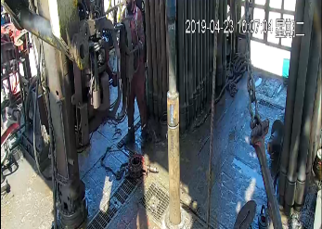
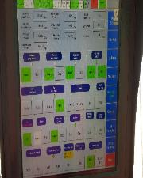
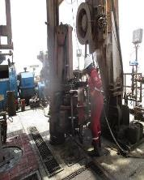
PDO Second Alert
Date: 23rd April 2019 Incident: HiPo#34
What happened?
Operation was breaking out the lifting sub from drill collar, floor man attempted to park the iron roughneck, mistakenly he extended the iron roughneck instead of lowering it to park position which caused his shoulder to be trapped between iron roughneck & drill pipe stands resulted in minor swelling with bruises.
Your learning from this incident..
Always stay away of LoF.
Keep good housekeeping all the time.
Always follow the correct sequence for parking equipment
Floorman trapped between iron roughneck and drill pipe stands
Isolate the ST-80 Iron roughneck prior tilting it
Ensure Iron roughneck switched off prior turning manually to parking spot.
Notes:
Ensure all dates and titles are input
A short description should be provided without mentioning names of contractors or individuals. You should include, what happened, to who (by job title) and what injuries this resulted in. Nothing more!
Four to five bullet points highlighting the main findings from the investigation. Remember the target audience is the front line staff so this should be written in simple terms in a way that everyone can understand.
The strap line should be the main point you want to get across
The images should be self explanatory, what went wrong (if you create a reconstruction please ensure you do not put people at risk) and below how it should be done.

Slide 2
Management self audit
Date: 23rd April 2019 Incident: HiPo#34
As a learning from this incident and ensure continual improvement all contract
managers must review their HSE HEMP against the questions asked below
Confirm the following:
Do you ensure regular update of operating standard & procedure ?
Do you ensure your procedure is aligned with OEM manual?
Do you ensure that the procedure provided and effectively communicate to all personal?
Do you ensure line of fire known and controlled?
Do you ensure effective dynamic risk review during TBTs & adequate task supervision?
Do you ensure the processes and procedures are followed at site?
* If the answer is NO to any of the above questions please ensure you take action to correct this finding.
Notes:
Ensure all dates and titles are input
Make a list of closed questions (only ‘yes’ or ‘no’ as an answer) to ask others if they have the same issues based on the management or HSE-MS failings or shortfalls identified in the investigation.
Imagine you have to audit other companies to see if they could have the same issues.
These questions should start with: Do you ensure…………………?

