Slide 1
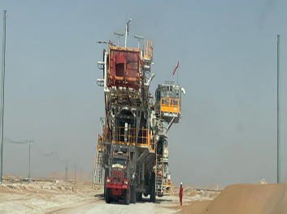
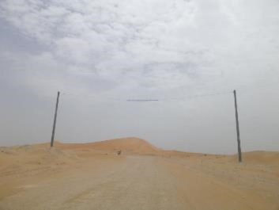
PDO Second Alert
Date: 14th May 2019 Incident HiPo#36
What happened?
During the rig move from Lekhwair 934 to MAZ 22 the monkey board fallarester pole on the main rig carrier came into contact with the 13m goalpost cable causing the cable to snap and fall to the ground
Your learning from this incident.
Always report incidents when they happen
Ensure the crews prepare the loads properly for rig move (safe heights understood)
Second means required to assure that the loads are safe to transport off of location
It does not leave location if it is too high.
Notes:
Ensure all dates and titles are input
A short description should be provided without mentioning names of contractors or individuals. You should include, what happened, to who (by job title) and what injuries this resulted in. Nothing more!
Four to five bullet points highlighting the main findings from the investigation. Remember the target audience is the front line staff so this should be written in simple terms in a way that everyone can understand.
The strap line should be the main point you want to get across
The images should be self explanatory, what went wrong (if you create a reconstruction please ensure you do not put people at risk) and below how it should be done.

Slide 2
Management self audit
Date: 14th May 2019 Incident HiPo#36
As a learning from this incident and ensure continual improvement all contract
managers must review their HSE HEMP against the questions asked below
Confirm the following:
Do you ensure that the rig move pre-tour safety meeting covers over head obstacles
Do you ensure that spotters will be placed next to each over head obstacles.
Do you ensure that a survey and scout route map will be signed off and distributed to all vehicles
Do you ensure that the HEMP will cover all hazards connected to rig moves and communicated to all personnel.
* If the answer is NO to any of the above questions please ensure you take action to correct this finding.
Notes:
Ensure all dates and titles are input
Make a list of closed questions (only ‘yes’ or ‘no’ as an answer) to ask others if they have the same issues based on the management or HSE-MS failings or shortfalls identified in the investigation.
Imagine you have to audit other companies to see if they could have the same issues.
These questions should start with: Do you ensure…………………?

