Slide 1
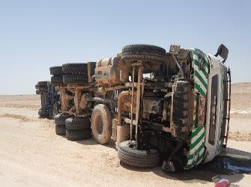
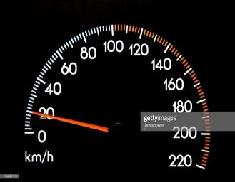
PDO Second Alert
Date: 27th May 2019 Incident: HiPo #37
What happened?
On 27th May 2019 at approximately 06:55 hours, a prime mover with trailer carrying chemical bag, whilst approaching a T-junction on a graded road the driver failed to slow the vehicle sufficiently, on attempting to take the right turn at the junction the driver lost control of the vehicle resulting in it tipping over on to the driver side. The driver was uninjured. The vehicle received light damage and 1 of the chemical bags dislodged from the trailer also being damaged.
Your learning from this incident.
Always ensure you drive at a speed according to the road conditions
Always follow road signs for roundabouts, sharp bends, corners and junctions
Always ensure you follow your defensive driver training
Ensure you take you leave as per your leave/shift pattern, to avoid unnecessary fatigue
Ensure you Slow down at junctions

Slide 2
Management self audit
Date: 27th May 2019 Incident: HiPo #37
As a learning from this incident and ensure continual improvement all contract
managers must review their HSE HEMP against the questions asked below
Confirm the following:
Do you ensure your communicate all learnings from incidents to your employees and they are understood?
Do you have staff trained to conduct reflective learnings to your employees for learnings from incidents?
Do you ensure your drivers are competent to conduct there own driver daily defect report?
Do you ensure staff are sent on leave as per there leave rotation?
Do you conduct in depth analysis of IVMS monitoring / driver habits?
* If the answer is NO to any of the above questions please ensure you take action to correct this finding.
Notes:
Ensure all dates and titles are input
Make a list of closed questions (only ‘yes’ or ‘no’ as an answer) to ask others if they have the same issues based on the management or HSE-MS failings or shortfalls identified in the investigation.
Imagine you have to audit other companies to see if they could have the same issues.
These questions should start with: Do you ensure…………………?

