Slide 1
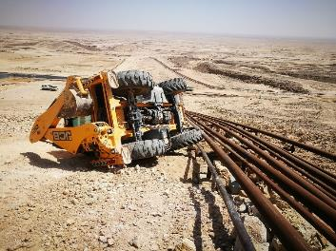
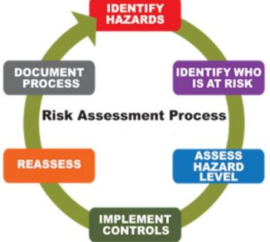
PDO Second Alert
Date: 2nd June 2019 Incident title: HiPo#38
What happened?
On 02nd June 2019, a JCB Backhoe was engaged in dumping soil for back filling foundations which have been damaged in recent rain. Due to uneven slope surface, the JCB operator lost control which resulted in equipment hitting 3’’ and 6’’ flowline and finally tilting to its left hand side.The operator was un injured during the incident, while JCB and 3” flowline were slightly damaged.
Your learning from this incident..
Permit applicants to conduct site visits before and after permit issuances to verify site conditions.
Prior to start, Identify the hazards involved in the activity and conduct TBT briefing the hazards to the crew members.
Any adhoc activity under the same permit ,identify the hazards involved before executing the task.
Assess and deploy experienced and competent operator while working in critical area.
“Speak up if not comfortable
Notes:
Ensure all dates and titles are input
A short description should be provided without mentioning names of contractors or individuals. You should include, what happened, to who (by job title) and what injuries this resulted in. Nothing more!
Four to five bullet points highlighting the main findings from the investigation. Remember the target audience is the front line staff so this should be written in simple terms in a way that everyone can understand.
The strap line should be the main point you want to get across
The images should be self explanatory, what went wrong (if you create a reconstruction please ensure you do not put people at risk) and below how it should be done.

Slide 2
Management self audit
Date: 2nd June 2019 Incident title: HiPo#38
As a learning from this incident and ensure continual improvement all contract
managers must review their HSE HEMP against the questions asked below
Confirm the following:
Do you ensure correct equipment used for all the activity?
Do you ensure your HEMP covers all the hazards involved in each task and is communicated to your workforce?
Do you ensure TBT conducted and covers all associated hazards, risks and mitigation for the activity?
Do you empower your team to stop unsafe act/condition?
Do you ensure operator is competent to perform the activity?
Do you ensure adhoc work and risk mitigation?
Do you ensure safe speed operation?
Do you ensure to ask before execution?
Do you ensure all jobs are planned?
* If the answer is NO to any of the above questions please ensure you take action to correct this finding.
Notes:
Ensure all dates and titles are input
Make a list of closed questions (only ‘yes’ or ‘no’ as an answer) to ask others if they have the same issues based on the management or HSE-MS failings or shortfalls identified in the investigation.
Imagine you have to audit other companies to see if they could have the same issues.
These questions should start with: Do you ensure…………………?

