Slide 1
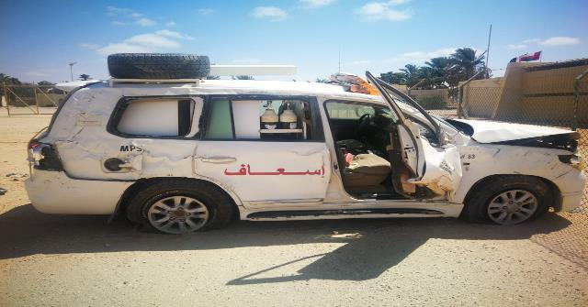
PDO Second Alert
Date: 4th June 2019 Incident :HiPo#39
What happened?
On 4th of June 2019 at 10:00 AM driver1 drove the emergency vehicle from MCT to Marmul after repair. The journey plan was to have a second driver who will be picked up on the way, the drivers and the supervisor agreed that driver2 will continue the journey alone at approximately 22:30hrs, on Rima road driver2 lost control of the vehicle, the vehicle rolled over with 3 rotations on the left side of the driver ,Driver (2) was taken immediately after the incident to Rima hospital.
Your learning from this incident.
Ensure effective communication between JM &driver
Driver should take enough rest before starting the journey
Ensure the effectiveness of the monitoring system
No night driving except for emergency cases
Stop driving if you feel fatigue
Notes:
Ensure all dates and titles are input
A short description should be provided without mentioning names of contractors or individuals. You should include, what happened, to who (by job title) and what injuries this resulted in. Nothing more!
Four to five bullet points highlighting the main findings from the investigation. Remember the target audience is the front line staff so this should be written in simple terms in a way that everyone can understand.
The strap line should be the main point you want to get across
The images should be self explanatory, what went wrong (if you create a reconstruction please ensure you do not put people at risk) and below how it should be done.

Slide 2
Management self audit
Date: 4th June 2019 Incident :HiPo#39
As a learning from this incident and ensure continual improvement all contract
managers must review their HSE HEMP against the questions asked below
Confirm the following:
Do you ensure that HEMP is reviewed and put additional controls if necessary ?
Do you ensure effective communication between driver and JM?
Do you ensure that all drivers included during awareness sessions of road safety related hazards ?
Do you conduct internal audit to check the JM system effectiveness ?
Do you ensure the vehicle up to date with RAS inspection ?
Did the consequence matrix of road safety SP 2000 have been circulated and acknowledged ?
If the answer is NO to any of the above questions please ensure you take action to correct this finding.
Notes:
Ensure all dates and titles are input
Make a list of closed questions (only ‘yes’ or ‘no’ as an answer) to ask others if they have the same issues based on the management or HSE-MS failings or shortfalls identified in the investigation.
Imagine you have to audit other companies to see if they could have the same issues.
These questions should start with: Do you ensure…………………?

