Slide 1
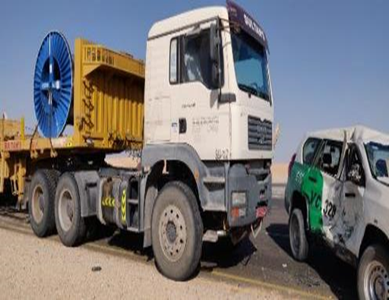

PDO Second Alert
Date: 9th June 2019 Incident: HiPo#40
What happened?
Driver of the Land Cruiser Prado was waiting for an employee from Muscat by bus. He stopped next to the passenger rest shed off road near the T junction. The employee, after alighting from the bus, waived to the driver who responded with an impulsive action of crossing the carriageway from his position. On seeing the Prado entering the carriageway, the third party trailer Driver tried to maneuver the vehicle to his right. However he could not avoid the collision. The accident resulted in extensive damage to the Prado and minor damage to the trailer. The Prado Driver got minor abrasion injuries on his right hand whereas the Trailer driver escaped unhurt.
Your learning from this incident.
Always use designated road meant for safe travel; avoid shortcut.
Always follow road markings and traffic signs.
Always check that the traffic on both sides is clear while entering / crossing the road.
Always pause and think before responding to a situation.
Report unsafe condition to your Supervisor.
DO NOT PUT YOUR LIFE IN THE LINE OF FIRE

Slide 2
Management self audit
Date: 9th June 2019 Incident: HiPo#40
As a learning from this incident and ensure continual improvement all contract
managers must review their HSE HEMP against the questions asked below
Confirm the following:
Do you ensure that the risks associated with peripheral activities involving journeys are captured in your HEMP?
Do you ensure that the key HSE information regarding commuting is available and incorporated while carrying out risk assessment?
Do you ensure that learnings from incidents are incorporated while assessing risks or reviewing HEMP?
Do you ensure that such risks are periodically audited and reviewed by the management?
Do you ensure that commuting risks are escalated to the management including client for their intervention and action?
Notes:
Make a list of closed questions (only ‘yes’ or ‘no’ as an answer) to ask other contractors if they have the same issues based on the management or HSE-MS failings or shortfalls identified in the investigation. Pretend you have to audit other companies to see if they could have the same issues.

