Slide 1
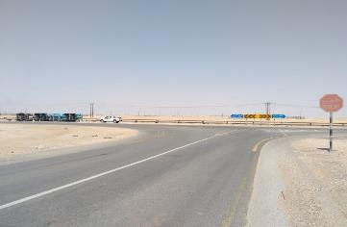
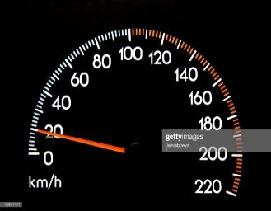
PDO Second Alert
Date: 26th May 2019 Incident title: HiPo #41
What happened?
A water tanker on route to the Saih Rawl R/O Plant, was involved in a vehicle roll over incident. Whilst approaching a T-junction on a black top road at 40-45kph, the tanker driver manoeuvred the tanker to the left, onto the opposite lane cutting the corner in an attempt to take the left turn at the T-junction. The harsh manoeuvre resulted in the tanker tipping over on to it’s passenger side, striking a road sign on the opposite side of the T-junction and coming to rest on the sand at the side of the road. The Driver was able to exit the vehicle through the windscreen and pulled the Helper out from the passenger seat. Both were then taken by ambulance to the Ghaba Clinic, and later referred to Nizwa hospital.
Your learning from this incident..
Always ensure you are competent and fully trained to drive the vehicle you are assigned
Always ensure you follow your defensive driver training
Always ensure you look ahead and try to predict and react to 3rd Party vehicle movements
Always ensure you follow the posted speed limit
Always follow road signs for roundabouts, sharp bends, corners and junctions
Ensure you Slow down at junctions
Notes:
Ensure all dates and titles are input
A short description should be provided without mentioning names of contractors or individuals. You should include, what happened, to who (by job title) and what injuries this resulted in. Nothing more!
Four to five bullet points highlighting the main findings from the investigation. Remember the target audience is the front line staff so this should be written in simple terms in a way that everyone can understand.
The strap line should be the main point you want to get across
The images should be self explanatory, what went wrong (if you create a reconstruction please ensure you do not put people at risk) and below how it should be done.

Slide 2
Management self audit
Date: 26th May 2019 Incident title: HiPo #41
As a learning from this incident and ensure continual improvement all contract
managers must review their HSE HEMP against the questions asked below
Confirm the following:
Do you ensure your communicate all learnings from incidents to all your employees and they are understood?
Do you ensure that new or renewed DD training is conducted at the appropriate times stated within a return to work program?
Do you have a competency assessment process in place for heavy drivers (does it check reactions to potential incidents)?
Do you have staff trained to conduct reflective learnings to your employees?
Do you ensure you follow the minimum requirements for IVMS monitoring as per SP2000?
Do you conduct in depth analysis of IVMS monitoring / driver habits and IVMS key checks on each individual driver?
* If the answer is NO to any of the above questions please ensure you take action to correct this finding.
Notes:
Ensure all dates and titles are input
Make a list of closed questions (only ‘yes’ or ‘no’ as an answer) to ask others if they have the same issues based on the management or HSE-MS failings or shortfalls identified in the investigation.
Imagine you have to audit other companies to see if they could have the same issues.
These questions should start with: Do you ensure…………………?

