Slide 1
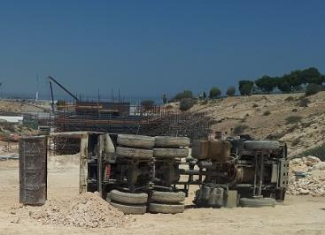
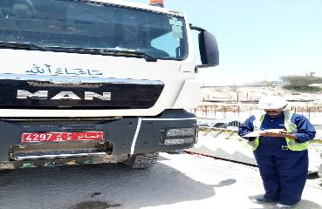
PDO Second Alert
Date: 2nd June 2019 Incident title: HiPo#42
What happened?
Upon reaching the crushing area, one of the rear left tire burst after driver took left turn for reversing to dump the excavated material. Driver operated the Hydraulic jack to reduce load partially. This action of the tipper driver resulted in to the sudden change of the center of gravity and the tipper toppled to its left side.
Your learning from this incident.
Ensure that your equipment is in good working condition prior to start of task.
Ensure vehicle is parallel to the slope during unloading materials
Never start to use your vehicle or equipment until the defects are rectified.
Ensure that all unsafe act are intervened, reported and stopped.
Ensure inspection Findings are shared , followed up and closed out.
Ensure Subcontractors are aware and comply with site HSE requirements.
Don’t Assume, Seek Help
Notes:
Ensure all dates and titles are input
A short description should be provided without mentioning names of contractors or individuals. You should include, what happened, to who (by job title) and what injuries this resulted in. Nothing more!
Four to five bullet points highlighting the main findings from the investigation. Remember the target audience is the front line staff so this should be written in simple terms in a way that everyone can understand.
The strap line should be the main point you want to get across
The images should be self explanatory, what went wrong (if you create a reconstruction please ensure you do not put people at risk) and below how it should be done.

Slide 2
Management self audit
Date: 2nd June 2019 Incident title: HiPo#42
As a learning from this incident and ensure continual improvement all contract
managers must review their HSE HEMP against the questions asked below
Confirm the following:
Do you Ensure all equipment and vehicles are checked on daily basis?
Do you Ensure monthly and preventive maintenance are carried out, Reported and recorded?
Do you Ensure ground conditions are checked prior to unloading of materials?
Do you Ensure worn out tires are replaced Immediately.
* If the answer is NO to any of the above questions please ensure you take action to correct this finding.
Notes:
Ensure all dates and titles are input
Make a list of closed questions (only ‘yes’ or ‘no’ as an answer) to ask others if they have the same issues based on the management or HSE-MS failings or shortfalls identified in the investigation.
Imagine you have to audit other companies to see if they could have the same issues.
These questions should start with: Do you ensure…………………?

