Slide 1
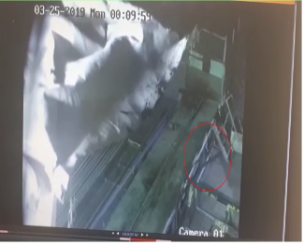
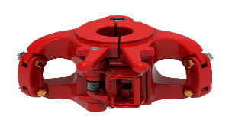
PDO Second Alert
Date: 4th June 2019 Incident title: HiPo#43
What happened?
Operation was pull out of hole and lay down 4 joints of 2 7/8” DP which was used for fishing BHA. While pull out the 2nd joint of 2 7/8” DP, Rig crew started to breakout the DP by using Power tong, after the connection was open, the tong Jaws jammed to DP tool joint ,So the crew tried to released it by turning tong forth and back, and due to dynamic movement of the connection, the thread between drill pipe and the cross over was unscrewed, after the tong came out from the joint, and while the crew were moving the joint to the v door side, the connection between the crossover and the joint completely opened and the 2 7/8 DP slid from V-door to cat walk and then to the ground.
Your learning from this incident.
Always use the correct size of handling tools for the tubular in use.
All rental equipment should be verified once received on site .
Insure reporting any deviation from the original plan to the management with a proper Risk assessment and MOC is in place .
Always encourage rig supervisors and crew to intervene the job if it is deviated from normal rig practice.
Always use the correct & proper handling tools for the tubular in use
Notes:
Ensure all dates and titles are input
A short description should be provided without mentioning names of contractors or individuals. You should include, what happened, to who (by job title) and what injuries this resulted in. Nothing more!
Four to five bullet points highlighting the main findings from the investigation. Remember the target audience is the front line staff so this should be written in simple terms in a way that everyone can understand.
The strap line should be the main point you want to get across
The images should be self explanatory, what went wrong (if you create a reconstruction please ensure you do not put people at risk) and below how it should be done.

Slide 2
Management self audit
Date: 4th June 2019 Incident title: HiPo#43
As a learning from this incident and ensure continual improvement all contract
managers must review their HSE HEMP against the questions asked below
Confirm the following:
Do you always ensure the correct tools are used ?
Do you ensure that all risk are being identified and captured in the TBT?
Do you ensure your crew members use the hazard identification and assessment tools properly and meaningfully?
Do you ensure your rig team aware of their empowerment to stop and do they use it often to stop unsafe and uncompliant practices?
Do you ensure that all operation changes also covered with MOC process and Proper RA?
Notes:
Ensure all dates and titles are input
Make a list of closed questions (only ‘yes’ or ‘no’ as an answer) to ask others if they have the same issues based on the management or HSE-MS failings or shortfalls identified in the investigation.
Imagine you have to audit other companies to see if they could have the same issues.
These questions should start with: Do you ensure…………………?

