Slide 1
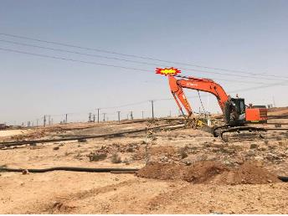
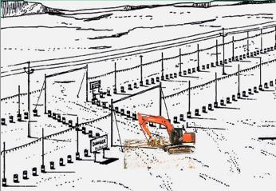
PDO Second Alert
Date: 29th June 2019 Incident title: Hipo# 45
What happened?
Civil crew was deployed for excavation activity for anchor foundation at Qata field. At around 1110hrs the rock breaker while crossing underneath a nearby 33KV OHL, the boom touched the conductor and resulted in damage of OHL conductor and interruption of power supply to some production wells at Qata filed. No injury to personnel.
Your learning from this incident.
Always ensure availability OHL clearance certificate while working near / under OHL
Always ensure erection of temporary goal post before allowing heavy equipment to cross under OHL.
Always ensure that excavator should not be moved without a clear direction from a banksman.
Ensure Dynamic Risk Review is performed on any changes in site activity/conditions.
Obtain authorization and ensure controls in place before crossing OHL
Notes:
Ensure all dates and titles are input
A short description should be provided without mentioning names of contractors or individuals. You should include, what happened, to who (by job title) and what injuries this resulted in. Nothing more!
Four to five bullet points highlighting the main findings from the investigation. Remember the target audience is the front line staff so this should be written in simple terms in a way that everyone can understand.
The strap line should be the main point you want to get across
The images should be self explanatory, what went wrong (if you create a reconstruction please ensure you do not put people at risk) and below how it should be done.

Slide 2
Management self audit
Date: 29th June 2019 Incident title: Hipo# 45
As a learning from this incident and ensure continual improvement all contract
managers must review their HSE HEMP against the questions asked below
Confirm the following:
Do you ensure that crew is obtaining appropriate clearance certificate while working near OHL?
Do you ensure appropriate controls are in place such as installation of temporary goal post and valid permit while working near /under OHL ?
Do your supervisor conduct DRR when they observe changes in the site conditions?
Do your Supervisor explain about PTW requirements with appropriate control measures to crew at site?
Do your plant equipment operator ensure that the movement of plant as per banksman signal?
* If the answer is NO to any of the above questions please ensure you take action to correct this finding.
Notes:
Ensure all dates and titles are input
Make a list of closed questions (only ‘yes’ or ‘no’ as an answer) to ask others if they have the same issues based on the management or HSE-MS failings or shortfalls identified in the investigation.
Imagine you have to audit other companies to see if they could have the same issues.
These questions should start with: Do you ensure…………………?

