Slide 1
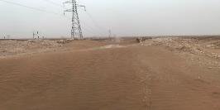
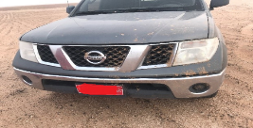

PDO Second Alert
Date:20th June 2019 Incident title: HiPo#47
What Happened?
Sub contractor service team called out to rig site for servicing the cherry picker, the team started from town without journey plan using uninspected vehicle and unauthorized driver. After reaching camp and stay overnight the team proceed to the location using short cut road (Electricity poles service and pipe line routes).
The road was in bad condition as it is not paved, therefore and while driving in high speed the vehicle hit a high sand dune result in damaging the water radiator and passengers sustained minor bruises due to harsh impact.
Your learning from this incident..
Always ensure 3rd parties must report to the TP on their arrival.
Always follow road safety procedures.
Always before use vehicles make sure has valid inspection and in safe condition.
Always ensure journey plan approved from journey manger.
Always ensure all drivers should have valid defensive driving training.
Always ensure to plan all job and discussed with all work party.
Always use authorized route for Journey
Notes:
Ensure all dates and titles are input
A short description should be provided without mentioning names of contractors or individuals. You should include, what happened, to who (by job title) and what injuries this resulted in. Nothing more!
Four to five bullet points highlighting the main findings from the investigation. Remember the target audience is the front line staff so this should be written in simple terms in a way that everyone can understand.
The strap line should be the main point you want to get across
The images should be self explanatory, what went wrong (if you create a reconstruction please ensure you do not put people at risk) and below how it should be done.

Slide 2
Management self audit
Date: 20th June 2019 Incident title: HiPo#47
As a learning from this incident and ensure continual improvement all contract
managers must review their HSE HEMP against the questions asked below
Confirm the following:
Do you ensure journey management system in place?
Do you ensure regular inspection of the vehicles and IVMS devices?
Do your ensure that 3rd party drivers and other employees have all mandatory trainings as required?
Do you ensure good communication between rig team and other visiting 3rd parties?
Do you ensure 3rd party pre-mobilization checklist is completed and all required evidences are provided prior visiting the site?
Notes:
Ensure all dates and titles are input
Make a list of closed questions (only ‘yes’ or ‘no’ as an answer) to ask others if they have the same issues based on the management or HSE-MS failings or shortfalls identified in the investigation.
Imagine you have to audit other companies to see if they could have the same issues.
These questions should start with: Do you ensure…………………?

