Slide 1
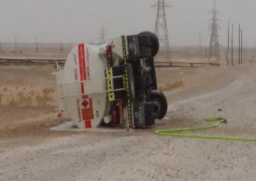
PDO Second Alert
Date:2nd August 2019 Incident title: HiPo#49
What happened?
A contractor diesel tanker was travelling from Al- Huwaisah station to Rabiha on graded road for an ad-hoc task of diesel fuel supply at a well location. At around 1.4 kms from Al-Huwaisah the driver lost control over the vehicle causing the tanker to roll over. The incident resulted in damage to the truck cabin and minor abrasion on the left arm of the driver.
Your learning from this incident..
Drivers:
Always drive as per the road conditions and apply defensive driving techniques
Planning Engineers/Supervisors/ Work schedulers:
Do not execute a task if you are not sure about the scope and hazards involved
Ensure proper planning and communication for ad-hoc tasks (not only vehicles)
Failing to plan is planning to fail
Notes:
Ensure all dates and titles are input
A short description should be provided without mentioning names of contractors or individuals. You should include, what happened, to who (by job title) and what injuries this resulted in. Nothing more!
Four to five bullet points highlighting the main findings from the investigation. Remember the target audience is the front line staff so this should be written in simple terms in a way that everyone can understand.
The strap line should be the main point you want to get across
The images should be self explanatory, what went wrong (if you create a reconstruction please ensure you do not put people at risk) and below how it should be done.

Slide 2
Management self audit
Date:2nd August 2019 Incident title: HiPo#49
As a learning from this incident and ensure continual improvement all contract
managers must review their HSE HEMP against the questions asked below
Confirm the following:
Do you ensure that you have a process/procedure to control ad-hoc tasks?
Do you ensure proper planning and attention to details for performing ad-hoc/non-routine tasks?
Do you ensure that you have asked enough questions to fully understand the ad-hoc tasks and hazards prior to execution?
Do you ensure drivers are fully aware of the details such as route, load, destination, hazards etc. before starting journey?
* If the answer is NO to any of the above questions please ensure you take action to correct this finding.
Notes:
Ensure all dates and titles are input
Make a list of closed questions (only ‘yes’ or ‘no’ as an answer) to ask others if they have the same issues based on the management or HSE-MS failings or shortfalls identified in the investigation.
Imagine you have to audit other companies to see if they could have the same issues.
These questions should start with: Do you ensure…………………?

