Slide 1
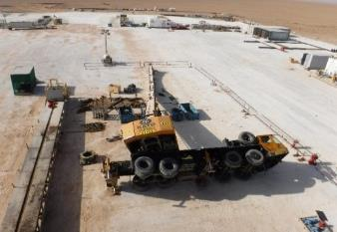
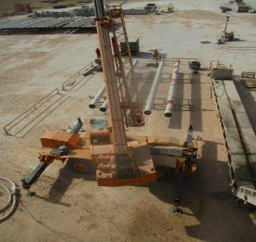
PDO Second Alert
Date: 16th Sept 2019 Incident Title: HiPo#54
What happened?
A 50 MT crane lowered the elevator links from rig floor to pipe rack area at the distance of 11 meters from the crane with the boom length of 24 meters, then crane boom swung 7 meters to the right and was lowered to lift casing circulating/fill up tool at the distance of 14 meters, crane tipped over damaging the boom. No injuries.
Your learning from this incident..
Ensure Lifting Supervisor is supervising the lifting operation.
Ensure the lifting area is barricaded during lifting operation
Ensure to STOP the operation on finding unsafe condition or act.
Ensure the implementation of lift plan, TRIC and JSA for all non-routine lifting jobs.
Crane tipped over
Ensure outriggers are fully extended and locked on firm footing prior lifting operation.
Crane with extended outrigger’s
Notes:
Ensure all dates and titles are input
A short description should be provided without mentioning names of contractors or individuals. You should include, what happened, to who (by job title) and what injuries this resulted in. Nothing more!
Four to five bullet points highlighting the main findings from the investigation. Remember the target audience is the front line staff so this should be written in simple terms in a way that everyone can understand.
The strap line should be the main point you want to get across
The images should be self explanatory, what went wrong (if you create a reconstruction please ensure you do not put people at risk) and below how it should be done.

Slide 2
Management self audit
Date: 16th Sept 2019 Incident Title: HiPo#54
As a learning from this incident and ensure continual improvement all contract
managers must review their HSE HEMP against the questions asked below
Confirm the following:
Do you ensure adequate supervision for all lifting operations?
Do you ensure risk assessments/ lifting plan of lifting operations are conducted adequately and ensured the required controls are implemented and maintained?
Do you ensure lifting plans are created & approved for all lifting operations?
Do you ensure crane operators is a part of your competency program?
Do you ensure compliance of sub-contractor audit?
Do you ensure all involved personal attended the TBT?
* If the answer is NO to any of the above questions please ensure you take action to correct this finding.
Notes:
Ensure all dates and titles are input
Make a list of closed questions (only ‘yes’ or ‘no’ as an answer) to ask others if they have the same issues based on the management or HSE-MS failings or shortfalls identified in the investigation.
Imagine you have to audit other companies to see if they could have the same issues.
These questions should start with: Do you ensure…………………?

