Slide 1
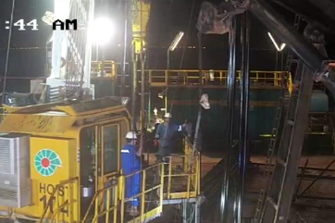
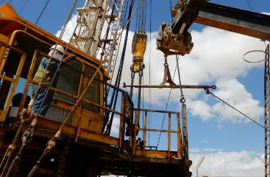
PDO Second Alert
Date: 23rd September 2019 Incident: HiPo#55
What happened?
While lifting up the 1.48m turnbuckle (used for the power swivel tension lines) to the hoist floor by the Telehandler, the turnbuckle securing pin came in contact with the floor handrail (17.75kg) and causing the handrail to be lifted
off its brackets and falling down to the ground (2.75m).
Your learning from this incident..
Always ensure all equipment are properly secured in place
Always ensure Forklift/crane operator follows Banksman signals
Always ensure Zone Management & LSR is respected
Turnbuckle
Turnbuckle
Always ensure forklift operator follow Banksman signals
Notes:
Ensure all dates and titles are input
A short description should be provided without mentioning names of contractors or individuals. You should include, what happened, to who (by job title) and what injuries this resulted in. Nothing more!
Four to five bullet points highlighting the main findings from the investigation. Remember the target audience is the front line staff so this should be written in simple terms in a way that everyone can understand.
The strap line should be the main point you want to get across
The images should be self explanatory, what went wrong (if you create a reconstruction please ensure you do not put people at risk) and below how it should be done.

Slide 2
Management self audit
Date: 23rd September 2019 Incident: HiPo#55
As a learning from this incident and ensure continual improvement all contract
managers must review their HSE HEMP against the questions asked below
Confirm the following:
Do you ensure that you train your personnel for crane and forklift signals?
Do you ensure that Responsible Supervisors are fully competent with using your company PTW?
Do you ensure that Banksman are provided with reflective jacket?
Do you ensure anything placed above ground is secured from accidental falling?
* If the answer is NO to any of the above questions please ensure you take action to correct this finding.
Notes:
Ensure all dates and titles are input
Make a list of closed questions (only ‘yes’ or ‘no’ as an answer) to ask others if they have the same issues based on the management or HSE-MS failings or shortfalls identified in the investigation.
Imagine you have to audit other companies to see if they could have the same issues.
These questions should start with: Do you ensure…………………?

