Slide 1
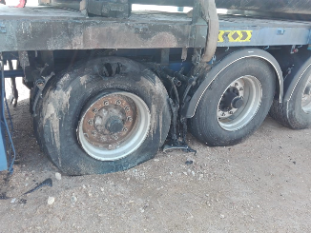

PDO Second Alert
Date: 10th September 2019 Incident title: HVL#3
What happened?
On the 10th September 2019 at 12:39hrs a Heavy Goods Vehicle on route to Yibal, suffered a fire to the trailer passenger side rear axle. On noticing the smoke the driver immediately stopped the vehicle, exited the cab and on seeing flames returned to the cab to switch off the ignition. The driver then attempted to extinguish the fire using 2 of his own fire extinguishers and 4 other fire extinguishers from other vehicles which were travelling behind him.
Your learning from this incident..
Do you ensure your vehicle undergoes regular maintenance and servicing as per manufacturers recommendations?
Do you ensure your vehicle is serviced and maintained at a reputable workshop?
Do you ensure you have the correct in date serviceable fire extinguishers?
Do you ensure you report all defects?
Do you ensure you follow the Safe Journey Management Procedure?
Emergency Response Numbers
5555 or 24675555 / 24385555
Ensure you call the correct Emergency Number in case of any incident

Slide 2
Management self audit
Date: 10th September 2019 Incident title: HVL#3
As a learning from this incident and ensure continual improvement all contract
managers must review their HSE HEMP against the questions asked below
Confirm the following:
Do you ensure all staff are aware of the correct emergency numbers and the requirement to call them?
Do you ensure vehicles in your fleet are maintained in accordance with manufacturers maintain and records of defects, servicing, maintenance and repairs recommendations?
Do you ensure vehicles are fitted with good quality parts and the vehicle is repaired and maintained at a reputable workshop?
Do you ensure your vehicles are SP2000 v4 complaint?
Do you ensure your Safe Journey Management Process is assured with audits and inspections?
* If the answer is NO to any of the above questions please ensure you take action to correct this finding.
Notes:
Ensure all dates and titles are input
Make a list of closed questions (only ‘yes’ or ‘no’ as an answer) to ask others if they have the same issues based on the management or HSE-MS failings or shortfalls identified in the investigation.
Imagine you have to audit other companies to see if they could have the same issues.
These questions should start with: Do you ensure…………………?

