Slide 1
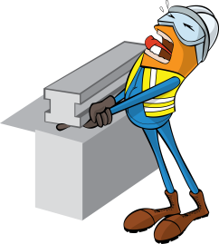
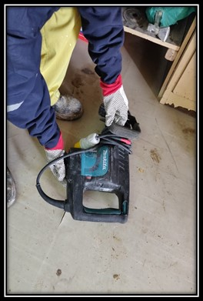
PDO Incident First Alert
Incident type | LTI (21)
Date/ time | 25.12.19@ 13:30hrs | Directorate
Location | Bahja | Dept
What happened
While the Mason was trying to take a hilty breaker from the rack, it fell hitting his right hand
Mr. Musleh asks the questions of can it happen to you?
Do you always follow the correct manual handling procedure?
Do you ensure all hazards are identified before performing the task?
Do keep your hands and fingers out of crush points?
Do you always consider if you are in the ‘line of fire’?
Please disseminate this LTI notification to your teams and use it in your tool box talks and HSE meetings and notice boards.

